Slide 1
CS 4700 / CS 5700
Network Fundamentals
Lecture 9: Inter Domain Routing
(It’s all about the Money)
Revised 10/21/2022

Slide 2
Network Layer, Control Plane
Function:
  Set up routes between networks
Key challenges:
  Implementing provider policies
  Creating stable paths
Data Plane
Application
Presentation
Session
Transport
Network
RIP
OSPF
BGP
Control Plane
Data Link
Physical

Slide 3
Outline
BGP Basics
Stable Paths Problem
Debugging BGP Path Problems

Slide 4



ASs, Revisited
AS-1
AS-3
Interior Routers
AS-2
BGP Routers

Slide 5
AS Numbers
Each AS identified by an ASN number
  32-bit values (originally 16-bit)
  64512 – 65535 are reserved
Currently, there are > 111,458 ASNs*
  AT&T: 5074, 6341, 7018, …
  Sprint: 1239, 1240, 6211, 6242, …
  Northeastern: 156
  North America ASs → ftp://ftp.arin.net/info/asn.txt
  https://www-public.imtbs-tsp.eu/~maigron/RIR_Stats/RIR_Delegations/World/ASN-ByNb.html

Slide 6
Inter-Domain Routing
Global connectivity is at stake!
  Thus, all ASs must use the same protocol
  Contrast with intra-domain routing
What are the requirements?
  Scalability
  Flexibility in choosing routes
    Cost
    Routing around failures
Question: link state or distance vector?
  Trick question: BGP is a path vector protocol

Slide 7
BGP
Border Gateway Protocol
  De facto inter-domain protocol of the Internet
  Policy based routing protocol
  Uses a Bellman-Ford path vector protocol
Relatively simple protocol, but…
  Complex, manual configuration
  Entire world sees advertisements
    Errors can screw up traffic globally
  Policies driven by economics
    How much $$$ does it cost to route along a given path?
    Not by performance (e.g. shortest paths)

Slide 8
BGP Relationships
Provider
P: x.y.z.0/24
Customer pays provider
A: a.b.c.0/24
B: d.e.f.0/24
C: q.0.0.0/8
…
Customer

Slide 9
BGP Relationships
Provider
Peer 2 has no incentive to route 1→ 3
Peers do not pay each other
Customer
Provider
Customer
Peer 1
Peer 2
Peer 3
Customer pays provider
Customer

Slide 10
Tier-1 ISP Peering
Cogent
NTT
Verizon Business
AT&T
Level 3
Sprint
Qwest
…

Slide 11
AS topology - 2017
https://www.caida.org/research/topology/as_core_network/pics/2017/ascore-2017-feb-ipv4-poster-2048x1518.png

Slide 12
Peering/Interconnection Wars
Peer
Don’t Peer
Reduce upstream costs
Improve end-to-end performance
May be the only way to connect to parts of the Internet
You would rather have customers
Peers are often competitors
Peering agreements require periodic renegotiation
Peering struggles in the ISP world are extremely contentious, agreements are usually confidential

Slide 13
Two Types of BGP Neighbors
Exterior routers also speak IGP
IGP
eBGP
eBGP
iBGP
iBGP

Slide 14
Full iBGP Meshes
Question: why do we need iBGP?
  IGP (intra-domain) does not include BGP policy info
  Prevents routing loops within the AS
iBGP updates do not trigger announcements
eBGP
iBGP

Slide 15
Path Vector Protocol
AS-path: sequence of ASs a route traverses
  Like distance vector, plus additional information
Used for loop detection and to apply policy
Default choice: route with fewest # of ASs
120.10.0.0/16: AS4
AS 4
120.10.0.0/16
120.10.0.0/16: AS 3 → AS4
AS 3
130.10.0.0/16
AS 5
AS 2
110.10.0.0/16
120.10.0.0/16: AS2 → AS 3 → AS4
120.10.0.0/16: AS 2 → AS 3 → AS 4
AS 1
130.10.0.0/16: AS 2 → AS 3
110.10.0.0/16: AS 2 → AS 5

Slide 16
BGP Operations (Simplified)
Establish session on TCP port 179
AS-1
Exchange active routes
BGP Session
AS-2
Exchange incremental updates

Slide 17
Four Types of BGP Messages
Open: Establish a peering session.
Keep Alive: Handshake at regular intervals.
Notification: Shuts down a peering session.
Update: Announce new routes or withdraw previously announced routes.
announcement = IP prefix + attributes values

Slide 18
CS 4700 / CS 5700
ECON 4700/5700
Network Fundamentals
Lecture 9: Inter Domain Routing
(It’s all about the Money)

Slide 19
BGP Attributes
Attributes used to select “best” path
  LocalPref
    Local preference policy to choose most preferred route
    Overrides default fewest AS behavior
  Multi-exit Discriminator (MED)
    Specifies path for external traffic destined for an internal network
    Chooses peering point for your network
  Import Rules
    What route advertisements do I accept?
  Export Rules
    Which routes do I forward to whom?

Slide 20
Route Selection Summary
Highest Local Preference
Enforce relationships
Shortest AS Path
Lowest MED
Traffic engineering
Lowest IGP Cost to BGP Egress
When all else fails,
break ties
Lowest Router ID

Slide 21
Shortest AS Path != Shortest Path
4 hops
4 ASs
9 hops
2 ASs
Source
?
?
Destination

Slide 22
Hot Potato Routing
5 hops total, 2 hops cost
Source
3 hops total,
3 hops cost
?
?
Destination

Slide 23
Review
What is BGP (and why BGP)
BGP Relationships
BGP Announcements
BGP Decision Process
Importing routes

Slide 24
Importing Routes
From Provider
ISP Routes
From Peer
From Peer
From Customer

Slide 25
Exporting Routes
$$$ generating routes
Customer and ISP routes only
To Provider
To Peer
To Peer
To Customer
Customers get all routes

Slide 26

Modeling BGP
AS relationships
  Customer/provider
  Peer
  Sibling, IXP
Gao-Rexford model
  AS prefers to use customer path, then peer, then provider
    Follow the money!
  Valley-free routing
  Hierarchical view of routing (not 100% accurate but frequently used)
P-P
P-P
C-P
P-C
P-C
P-P

Slide 27
AS Relationships: It’s Complicated
GR Model is strictly hierarchical
  Each AS pair has exactly one relationship
  Each relationship is the same for all prefixes
In practice it’s much more complicated
  Rise of widespread peering
  Regional, per-prefix peerings
  Tier-1’s being shoved out by “hypergiants”
  IXPs dominating traffic volume
Modeling is very hard, very prone to error
  Huge potential impact for understanding Internet behavior

Slide 28
Other BGP Attributes
AS_SET
  Instead of a single AS appearing at a slot, it’s a set of ASes
  Why?
Communities
  Arbitrary number that is used by neighbors for routing decisions
    Export this route only in Europe
    Do not export to your peers
  Sometimes stripped after first interdomain hop
  Why?
Prepending
  Lengthening the path vector by adding multiple instances of ASN
  Why?
Notes:
AS_SET - aggregation

Slide 29
Outline
BGP Basics
Stable Paths Problem
BGP in the Real World
Debugging BGP Path Problems

Slide 30
What Problem is BGP Solving?
Underlying Problem | Distributed Solution
Shortest Paths | RIP, OSPF, IS-IS, etc.
??? | BGP
Knowing ??? can:
  Aid in the analysis of BGP policy
  Aid in the design of BGP extensions
  Help explain BGP routing anomalies
  Give us a deeper understanding of the protocol

Slide 31
The Stable Paths Problem (SPP)
BGP can (always, sometimes, never) converge
BGP will solve for a “stable tree”
  Local equilibrium rather than global optimum
  Stable tree: each node has no preference to change from its current path
  Related to Nash Equilibrium from game theory
Relationship
  If No stable tree, BGP will never converge
  If Unique stable tree, BGP will converge optimally
  If Multiple stable trees, BGP may converge to any tree or may diverge
The Stable Paths Problem and Interdomain Routing, Timothy G. Griffin and F. Bruce Shepherd and Gordon Wilfong (2002)

Slide 32
The Stable Paths Problem
An instance of the SPP:
  Graph of nodes and edges
  Node 0, called the origin
  A set of permitted paths from each node to the origin
    Each set contains the null path
  Each set of paths is ranked
    Null path is always least preferred
2 1 0
2 0
5
5 2 1 0
2
2
4 2 0
4 3 0
4
0
1
3
3 0
1 3 0
1 0

Slide 33
A Solution to the SPP
A solution is an assignment of permitted paths to each node such that:
  Node u’s path is either null or uwP, where path wP is assigned to node w and edge u → w exists
  Each node is assigned the higest ranked path that is consistent
  with their neighbors
2 1 0
2 0
5
5 2 1 0
2
Solutions need not use the shortest paths, or form a spanning tree
2
4 2 0
4 3 0
4
0
1
3
3 0
1 3 0
1 0

Slide 34
Simple SPP Example
1 0
1 3 0
2 0
2 1 0
1
2
2
Each node gets its preferred route
Totally stable topology
0
3
4
3 0
4 3 0
4 2 0
4 2 0
4 3 0

Slide 35
Good Gadget
1 3 0
1 0
2 1 0
2 0
1
2
2
Not every node gets preferred route
Topology is still stable
Only one stable configuration
  No matter which router chooses first!
0
3
4
3 0
4 3 0
4 2 0

Slide 36
SPP May Have Multiple Solutions
1 2 0
1 0
1 2 0
1 0
1 2 0
1 0
1
1
1
0
0
0
2
2
2
2 1 0
2 0
2 1 0
2 0
2 1 0
2 0

Slide 37
Bad Gadget
1 3 0
1 0
2 1 0
2 0
That was only one round of oscillation!
This keeps going, infinitely
Problem stems from:
  Local (not global) decisions
  Ability of one node to improve its path selection
1
2
2
0
3
4
3 4 2 0
3 0
4 2 0
4 3 0

Slide 38
SPP Explains BGP Divergence
BGP is not guaranteed to converge to stable routing
  Policy inconsistencies may lead to “livelock”
  Protocol oscillation
Solvable
Can Diverge
Good Gadgets
Bad Gadgets
Must
Converge
Must
Diverge
Naughty Gadgets

Slide 39
Beware of Backup Policies
1 3 0
1 0
2 1 0
2 0
1
2
2
BGP is not robust
It may not recover from link failure
0
3
4
3 4 2 0
3 0
4 0
4 2 0
4 3 0

Slide 40
BGP is Precarious
If node 1 uses path 1 → 0, this is solvable
4 3 1 0
4 5 3 1 2 0
4 3 1 2 0
1 2 0
1 0
4
1
3 1 0
3 1 2 0
3
No longer stable
0
5
6
2
5 3 1 0
5 6 3 1 2 0
5 3 1 2 0
6 3 1 0
6 4 3 1 2 0
6 3 1 2 0
2 1 0
2 0

Slide 41
Can BGP Be Fixed?
Unfortunately, SPP is NP-complete
Possible Solutions
Static Approach
Dynamic Approach
Extend BGP to
detect and suppress
policy-based oscillations?
Automated Analysis
of Routing Policies
(This is very hard)
Inter-AS
coordination
These approaches are complementary

Slide 42
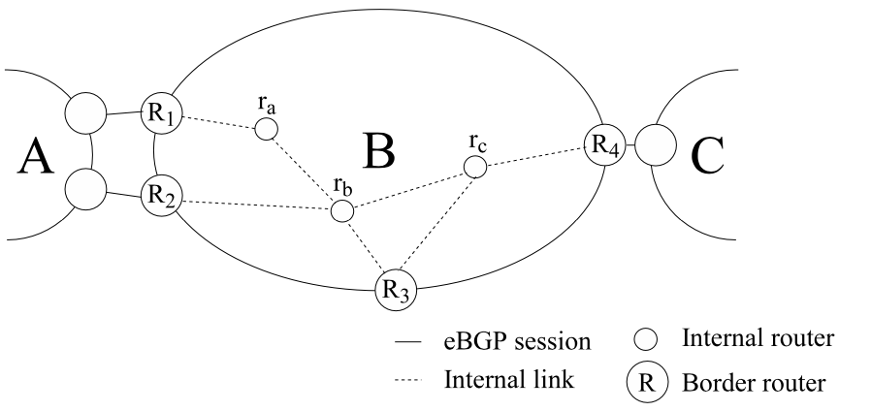
Paper discussion
Why is outgoing load balancing difficult?
Why is inbound load balancing even harder?
Route flap dampening
BGP security

Slide 43
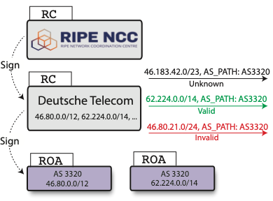

Slide 44
Outline
BGP Basics
Stable Paths Problem
BGP in the Real World
Debugging BGP Path Problems

Slide 45
Motivation
Routing reliability/fault-tolerance on small time scales (minutes) not previously a priority
Transaction oriented and interactive applications (e.g. Internet Telephony) will require higher levels of end-to-end network reliability
How well does the Internet routing infrastructure tolerate faults?
Notes:
Motivation → why we should care about convergence

Slide 46
Conventional Wisdom
Internet routing is robust under faults
  Supports path re-routing
  Path restoration on the order of seconds
BGP has good convergence properties
  Does not exhibit looping/bouncing problems of RIP
Internet fail-over will improve with faster routers and faster links
More redundant connections (multi-homing) will always improve fault-tolerance

Slide 47
Delayed Routing Convergence
Conventional wisdom about routing convergence is not accurate
  Measurement of BGP convergence in the Internet
  Analysis/intuition behind delayed BGP routing convergence
  Modifications to BGP implementations which would improve convergence times

Slide 48
Open Question
After a fault in a path to multi-homed site, how long does it take for majority of Internet routers to fail-over to secondary path?
Route Withdrawn
Routing table convergence
Stable end-to-end paths
Primary ISP
Customer
Backup ISP
Traffic

Slide 49
Bad News
With unconstrained policies:
  Divergence
  Possible create unsatisfiable policies
  NP-complete to identify these policies
  Happening today?
With constrained policies (e.g. shortest path first)
  Transient oscillations
  BGP usually converges
  It may take a very long time…
BGP Beacons: focuses on constrained policies

Slide 50
16 Month Study of Convergence
Instrument the Internet
  Inject BGP faults (announcements/withdrawals) of varied prefix and AS path length into topologically and geographically diverse ISP peering sessions
  Monitor impact faults through
    Recording BGP peering sessions with 20 tier1/tier2 ISPs
    Active ICMP measurements (512 byte/second to 100 random web sites)
  Wait two years (and 250,000 faults)

Slide 51
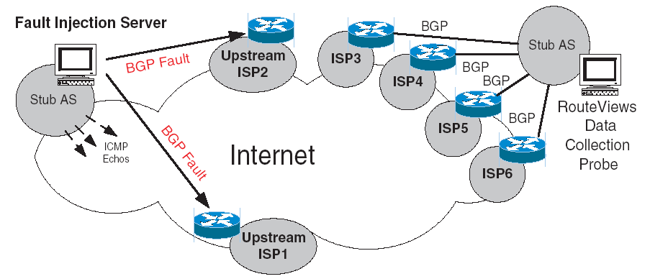
Measurement Architecture
Researchers pretending to be an AS
Researchers pretending to be an AS

Slide 52
Announcement Scenarios
Tup – a new route is advertised
Tdown – A route is withdrawn
  i.e. single-homed failure
Tshort – Advertise a shorter/better AS path
  i.e. primary path repaired
Tlong – Advertise a longer/worse AS path
  i.e. primary path fails

Slide 53
Major Convergence Results
Routing convergence requires an order of magnitude longer than expected
  10s of minutes
Routes converge more quickly following Tup/Repair than Tdown/Failure events
  Bad news travels more slowly
Withdrawals (Tdown) generate several more announcements than new routes (Tup)

Slide 54
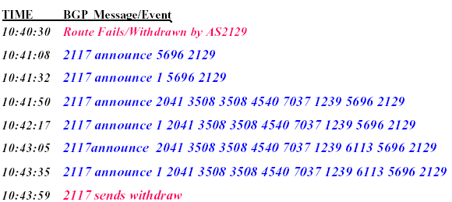
Example
BGP log of updates from AS2117 for route via AS2129
One withdrawal triggers 6 announcements and one withdrawal from 2117
Increasing AS path length until final withdrawal

Slide 55

Why So Many Announcements?
Events from AS 2177
Route Fails: AS 2129
Announce: 5696 2129
Announce: 1 5696 2129
Announce: 2041 3508 2129
Announce: 1 2041 3508 2129
Route Withdrawn: 2129
AS 2041
AS 3508
AS 1
AS 5696
AS 2129
AS 2117

Slide 56
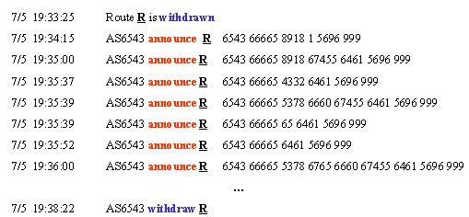
How Many Announcements Does it Take For an AS to Withdraw a Route?
Answer: up to 19

Slide 57
BGP Routing Table Convergence Times
New Route
Long->Short Fail-over
Short->Long Fail-Over
Failure
Less than half of Tdown events converge within two minutes
Tup/Tshort and Tdown/Tlong form equivalence classes
Long tailed distribution (up to 15 minutes)

Slide 58
Failures, Fail-overs and Repairs
Bad news does not travel fast…
Repairs (Tup) exhibit similar convergence as long-short AS path fail-over
Failures (Tdown) and short-long fail-overs (e.g. primary to secondary path) also similar
  Slower than Tup (e.g. a repair)
  80% take longer than two minutes
  Fail-over times degrade the greater the degree of multi-homing

Slide 59
Intuition for Delayed Convergence
There exists possible ordering of messages such that BGP will explore ALL possible AS paths of ALL possible lengths
BGP is O(N!), where N number of default-free BGP routers in a complete graph with default policy

Slide 60
Impact of Delayed Convergence
Why do we care about routing table convergence?
  It impacts end-to-end connectivity for Internet paths
ICMP experiment results
  Loss of connectivity, packet loss, latency, and packet re-ordering for an average of 3-5 minutes after a fault
Why?
  Routers drop packets when next hop is unknown
  Path switching spikes latency/delay
  Multi-pathing causes reordering

Slide 61
In real life …
Discussed worst case BGP behavior
In practice, BGP policy prevents worst case from happening
BGP timers also provide synchronization and limits possible orderings of messages

Slide 62
Outline
BGP Basics
Stable Paths Problem
Debugging BGP Path Problems

Slide 63
Control plane vs. Data Plane
Control:
  Make sure that if there’s a path available, data is forwarded over it
  BGP sets up such paths at the AS-level
Data:
  For a destination, send packet to most-preferred next hop
  Routers forward data along IP paths
How does the control plane know if a data path is broken?
  Direct-neighbor connectivity
  What if the outage isn’t in the direct neighbor?

Slide 64
Why Network Reliability Remains Hard
Visibility
  IP provides no built-in monitoring
  Economic disincentives to share information publicly
Control
  Routing protocols optimize for policy, not reliability
  Outage affecting your traffic may be caused by distant network
Detecting, isolating and repairing network problems for Internet paths remains largely a slow, manual process

Slide 65
Improving Internet Availability
New Internet design
  Monitoring everywhere in the network
  Visibility into all available routes
  Any operator can impact routes affecting her traffic
Challenges
  What should we monitor?
  What do we do with additional visibility?
  How to use additional control?

Slide 66
A Practical Approach
We can do this already in today’s Internet
  Crowdsourcing monitoring
  Use existing protocols/systems in unintended ways
Allows us to address problems today
  Also informs future Internet designs

Slide 67
Operators Struggle to Locate Failures
“Traffic attempting to pass through Level3’s network in the Washington, DC area is getting lost in the abyss. Here's a trace
from Verizon residential to Level3.” Outages mailing list, Dec. 2010
Mailing List User 2
1 Home router
2 Verizon in DC
3 Alter.net in DC
4 Level3 in DC
5 Level3 in Chicago
6 Level3 in Denver
7 * * *
8 * * *
Mailing List User 1
1 Home router
2 Verizon in Baltimore
3 Verizon in Philly
4 Alter.net in DC
5 Level3 in DC
6 * * *
7 * * *
Notes:
Why do they last so long?
Let’s take a look at how people deal with them today.
traceroute just trails off, didn’t receive a response from the destination.
Problem in DC? TR CAN’T TELL THE DIFFERENCE
No one on the mailing list ever indicated that they had any idea on the problem

Slide 68
Reasons for Long-Lasting Outages
Long-term outages are:
Repaired over slow, human timescales
Not well understood
Caused by routers advertising paths that do not work
  E.g., corrupted memory on line card causes black hole
  E.g., bad cross-layer interactions cause failed MPLS tunnel
Notes:
That example gives an idea of why problems last so long

Slide 69
Key Challenges for Internet Repair
Lack of visibility
  Where is the outage?
  Which networks are (un)affected?
  Who caused the outage?
Lack of control
  Reverse paths determined by possibly distant ASes
  Limited means to affect such paths
Notes:
That example gives an idea of why problems last so long

Slide 70
Goals and Approach
Improve availability through:
Failure isolation and remediation
Identifying the AS(es) responsible for path changes
Key techniques:
  Visibility
    Active measurements from distributed vantage points
    Passive collection of BGP feeds
  Control
    On-demand BGP prepending to route around outages
    Active BGP measurements to identify alternative paths
Notes:
That example gives an idea of why problems last so long

Slide 71
LIFEGUARD: Locating Internet Failures Effectively and
Generating Usable Alternate Routes Dynamically
Locate the ISP / link causing the problem
  Building blocks
  Example
  Description of technique
Suggest that other ISPs reroute around the problem
Notes:
Once problem resolves, revert
Colin Scott built LIFEGUARD’s failure location

Slide 72
Building blocks for failure isolation
LIFEGUARD can use:
Ping to test reachability
Traceroute to measure forward path
Distributed vantage points (VPs)
  PlanetLab for our experiments
  Some can source spoof
Reverse traceroute to measure reverse path (NSDI ’10)
  I’ll teach you about this during the security lecture
Atlas of historical forward/reverse paths between VPs and targets
Notes:
Want to build a system that works today, to locate problems even though paths are asym and failures uni.
So what tools do we have available?

Slide 73
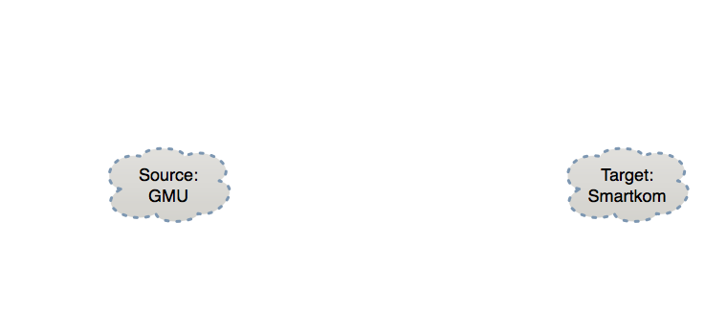






How Does LIFEGUARD Locate a Failure?
Before outage:
Historical
Current
  Historical atlas enables reasoning about changes
  Traceroute yields only path from GMU to target
  Reverse traceroute reveals path asymmetry
Notes:
TARGET (not destination)
Only showing some reverse paths, but measure all
Current approach is painful, slow and often misleading
We need more information to reason about an outage

Slide 74


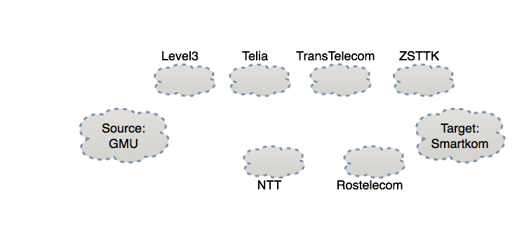

How Does LIFEGUARD Locate a Failure?
During outage:
Problem with ZSTTK?
Ping? Fr:VP
Ping! To:VP
Historical
Current
Forward path works
74
Notes:
Other vantage points allow a richer view and direction isolation

Slide 75
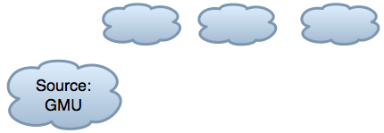

How Does LIFEGUARD Locate a Failure?
During outage:
NTT:Ping?
Fr:GMU
GMU:Ping!
Fr:NTT
Historical
Current
Forward path works
75
Notes:
Test which hops have paths to GMU

Slide 76

How Does LIFEGUARD Locate a Failure?
During outage:
Rostele:
Ping? Fr:GMU
Historical
Current
Forward path works
Rostelcom is not forwarding traffic towards GMU
76
Notes:
Draw a line where all hops on one side have working path to GMU and all hops on other side don’t have a working path

Slide 77
How LIFEGUARD Locates Failures
LIFEGUARD:
Maintains background historical atlas
Isolates direction of failure, measures working direction
Tests historical paths in failing direction in order to
prune candidate failure locations
Locates failure as being at the horizon of reachability
Notes:
Identifying where the problem is a big win
The operator can get in touch with the remote network causing the problem and YELL at them
But can we make the repair faster, without requiring the involvement of the other network?

Slide 78
Our Approach and Outline
LIFEGUARD: Locating Internet Failures Effectively and
Generating Usable Alternate Routes Dynamically
Locate the ISP / link causing the problem
Suggest that other ISPs reroute around the problem
  What would we like to add to BGP to enable this?
  What can we deploy today, using only available protocols
  and router support?
Notes:
So if we can locate a problem, how can we fix it?
Two parts. Abstraction we want
Protocol modifications face difficult path to adoption
What can we do that would be usable unilaterally w/o involvement of other ISPs?

Slide 79
Our Goal for Failure Avoidance
Enable content / service providers to repair
persistent routing problems affecting them,
regardless of which ISP is causing them
Setting
Assume we can locate problem
Assume we are multi-homed / have multiple data centers
Assume we speak BGP
We use TransitPortal to speak BGP to the real Internet:
5 US universities as providers
Notes:
Do something themselves, FWD or REV, without requiring involvement of the ISP

Slide 80
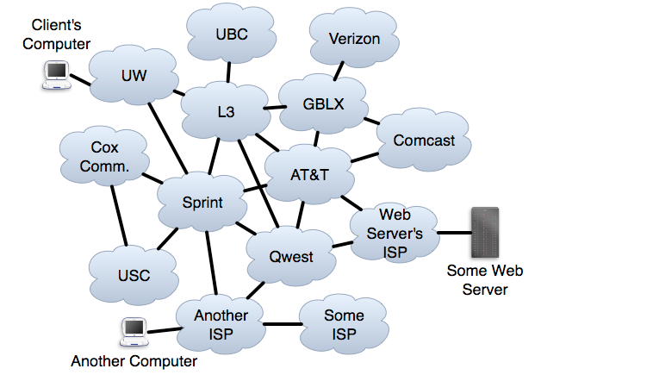
Self-Repair of Forward Paths
Notes:
Fix with path diversity.

Slide 81
A Mechanism for Failure Avoidance
Forward path: Choose route that avoids ISP or ISP-ISP link
Reverse path: Want others to choose paths to my prefix P
that avoid ISP or ISP-ISP link X
Want a BGP announcement AVOID(X,P):
  Any ISP with a route to P that avoids X uses such a route
  Any ISP not using X need only pass on the announcement
Notes:
Not enough to get multiple providers
Remember, we are talking about problems when router is advertising a route that doesn’t work
No direct way to control what they choose
Want a BGP announcement

Slide 82
Ideal Self-Repair of Reverse Paths
  AVOID(L3,WS)
  AVOID(L3,WS)
  AVOID(L3,WS)
82
Notes:
WS wants a way to control paths to it.
No direct control over path chosen
Signal “Don’t use L3 to reach the Web Server”

Slide 83
Do paths exist that AVOID problem?
LIFEGUARD repairs outages by instructing others to avoid particular routes.
Q: Do alternative routes exist?
A: Alternate policy-compliant paths exist in 90% of simulated AVOID(X,P) announcements.
Simulated 10 million AVOIDs on actual measured routes.
Notes:
Walk through simulation results.
Shows potential of having an avoid ABSTRACTION
But BGP is hard to change
Want to implement it now without changing protocol

Slide 84
Practical Self-Repair of Reverse Paths
UW → L3 → ATT → WS
L3 → ATT → WS
ATT → WS
Sprint → Qwest → WS
WS
AISP → Qwest → WS
Qwest → WS
84
Notes:
All it controls is what it announces - <CLICK>“hey guys, the server is over here, figure it out”
<CLICK THROUGH ANNOUNCEMENTS UNTIL FAILURE>
So how can it announce in a way that hints to others to route around L3?

Slide 85
Practical Self-Repair of Reverse Paths
UW → L3 → ATT → WS
UW → Sprint → Qwest → WS → L3→ WS
?
L3 → ATT → WS
ATT → WS
ATT → WS → L3→ WS
WS → L3→ WS
Sprint → Qwest → WS → L3→ WS
WS
Sprint → Qwest → WS
  AVOID(L3,WS)
AISP → Qwest → WS → L3→ WS
Qwest → WS → L3→ WS
AISP → Qwest → WS
Qwest → WS
BGP loop prevention encourages switch to working path.
85
Notes:
I’m going to show you how we can announce AVOID using a technique known as BGP POISONING
Need first WS so neighbors know the next hop
Need other WS to signal that WS owns prefix
Let’s see what the effect of that announcement is

Slide 86
Other results
Results from real poisonings
Poisoning in the wild / poisoning anomalies
Case study of restoring connectivity
Making poisoning flexible
  Monitoring broken path while it is disabled
  Allowing ISPs w/o alternatives to use disabled route
LIFEGUARD’s scalability
Overhead and speed of failure location
Router update load if many ISPs deploy our approach
Alternatives to poisoning
Compatibility with secure routing (BGPSEC, etc.)
Comparing to other route control mechanisms
Notes:
Say bold ones
See paper for details

Slide 87
Can poisoning approximate AVOID effects?
LIFEGUARD’s poisoning repairs outages by disabling routes to induce route exploration.
Q: Does poisoning disrupt working routes?
A: No. As I will describe:
Under certain circumstances, we can disable a link without disabling the full ISP.
We can speed BGP convergence by carefully crafting announcements.
Notes:
I’m proposing approximating a hypothetical future BGP mechanism with a trick that’s available today
I want to talk about how well we can approximate it without disrupting paths that aren’t broken.
KEY: (1) The poison only applies to the one network / prefix
(2) Network owner gets to decide - the choice to poison is up to the destination of the traffic
(3) So they can choose if a problem warrants poison, if important traffic isn’t working
(4) Any optimizations just make it so they can use it in more cases

Slide 88
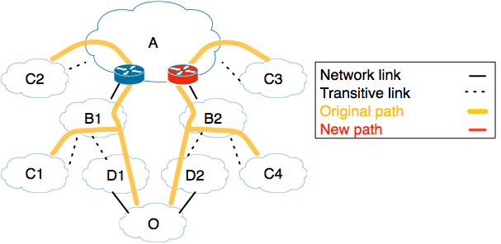
What if some routes in an ISP still work?
We only want C3 to change its route, to avoid A-B2
Notes:
We are a provider origin O, with clients C1-4
Suppose we locate the failure as being on an inter-domain link

Slide 89

What if some routes in an ISP still work?
We only want C3 to change its route, to avoid A-B2
Forward direction is easy: choose a different route
89
Notes:
Arrows are direction that traffic flows

Slide 90
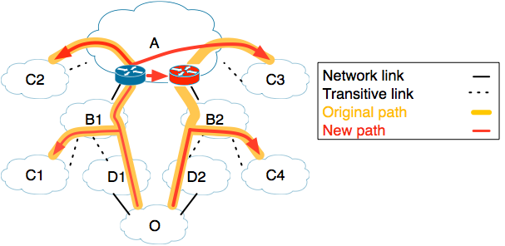
What if some routes in an ISP still work?
We only want C3 to change its route, to avoid A-B2
Forward direction is easy: choose a different route
90
Notes:
Let’s us avoid 90% of links in BGP-Mux 5-provider testbed

Slide 91
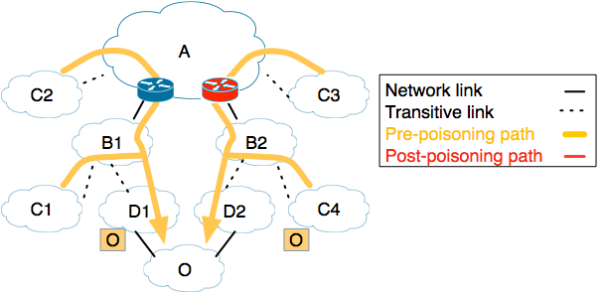
What if some routes in an ISP still work?
We only want C3 to change its route, to avoid A-B2
Poisoning seems blunt, disabling an entire ISP
Notes:
If we poison A, C2 will have to change route
If we stop advertising through P2, C4 will have to change route

Slide 92
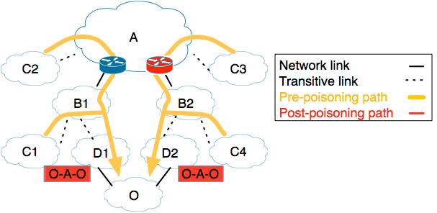
What if some routes in an ISP still work?
We only want C3 to change its route, to avoid A-B2
Poisoning seems blunt, disabling an entire ISP
92
Notes:
If we poison A, C2 will have to change route
If we stop advertising through P2, C4 will have to change route

Slide 93
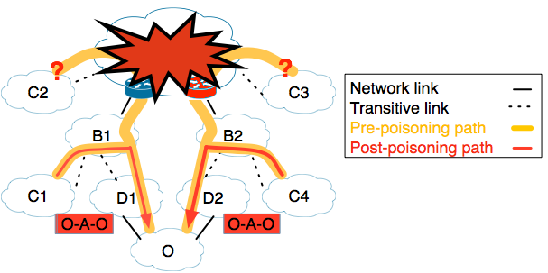
What if some routes in an ISP still work?
We only want C3 to change its route, to avoid A-B2
Poisoning seems blunt, disabling an entire ISP
93
Notes:
If we poison A, C2 will have to change route
If we stop advertising through P2, C4 will have to change route

Slide 94
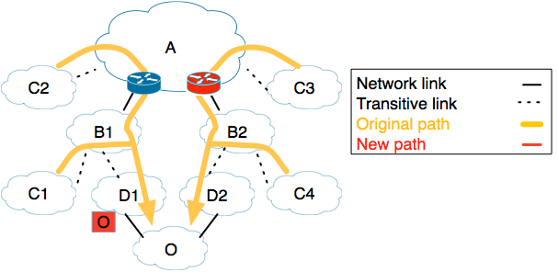
What if some routes in an ISP still work?
We only want C3 to change its route, to avoid A-B2
Poisoning seems blunt, disabling an entire ISP
Selective advertising via just D1 is also blunt
94
Notes:
If we poison A, C2 will have to change route
If we stop advertising through P2, C4 will have to change route

Slide 95
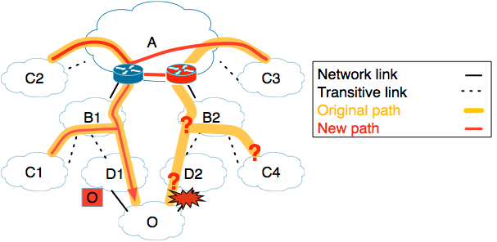
What if some routes in an ISP still work?
We only want C3 to change its route, to avoid A-B2
Poisoning seems blunt, disabling an entire ISP
Selective advertising via just D1 is also blunt
95
Notes:
If we poison A, C2 will have to change route
If we stop advertising through P2, C4 will have to change route

Slide 96
What if some routes in an ISP still work?
We only want C3 to change its route, to avoid A-B2
Poisoning seems blunt, disabling an entire ISP
If D1 and D2 (transitively) connect to different PoPs of A, selectively poison via D2 and not D1
96
Notes:
If we poison A, C2 will have to change route
If we stop advertising through P2, C4 will have to change route

Slide 97

What if some routes in an ISP still work?
We only want C3 to change its route, to avoid A-B2
Poisoning seems blunt, disabling an entire ISP
If D1 and D2 (transitively) connect to different PoPs of A, selectively poison via D2 and not D1
97
Notes:
Selectively poison A only via P2

Slide 98
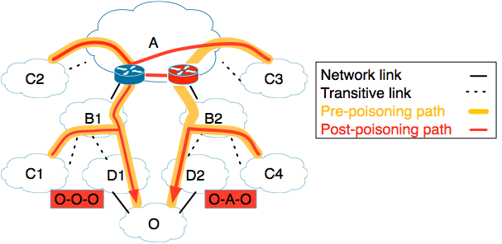
What if some routes in an ISP still work?
We only want C3 to change its route, to avoid A-B2
Poisoning seems blunt, disabling an entire ISP
If D1 and D2 (transitively) connect to different PoPs of A, selectively poison via D2 and not D1
Notes:
Selectively poison A only via P2

Slide 99
Can poisoning approximate AVOID effects?
LIFEGUARD’s poisoning repairs outages by disabling routes to induce route exploration.
Q: Does poisoning disrupt working routes?
A: No. As I will describe:
“Selective poisoning” can avoid 73% of links without disabling entire AS.
  Real-world results from 5 provider BGP-Mux testbed
We can speed BGP convergence by carefully crafting announcements.
Notes:
The new announcement will go to even ISPs that have working paths, triggering their route selection process

Slide 100
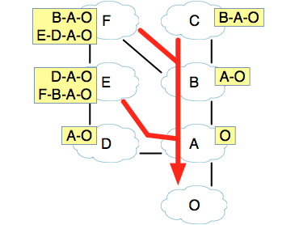
Naive Poisoning Causes Transient Loss
Some ISPs may have working paths that avoid problem ISP X
Naively, poisoning causes path exploration even for these ISPs
Path exploration causes transient loss
AVOID(X,P)
Notes:
These are their routing tables
For ones that receive more than one route, their chosen route is the top one
No one is using X, so with an ideal mechanism, no one would be affected, just pass on message

Slide 101
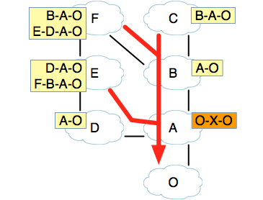
Naive Poisoning Causes Transient Loss
Some ISPs may have working paths that avoid problem ISP X
Naively, poisoning causes path exploration even for these ISPs
Path exploration causes transient loss
AVOID(X,P)
101

Slide 102
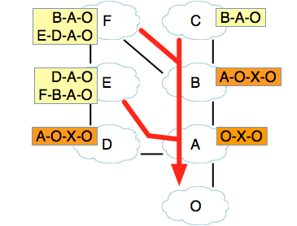
Naive Poisoning Causes Transient Loss
Some ISPs may have working paths that avoid problem ISP X
Naively, poisoning causes path exploration even for these ISPs
Path exploration causes transient loss
AVOID(X,P)

Slide 103
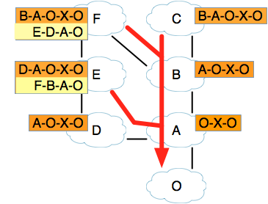
Naive Poisoning Causes Transient Loss
Some ISPs may have working paths that avoid problem ISP X
Naively, poisoning causes path exploration even for these ISPs
Path exploration causes transient loss
AVOID(X,P)
103

Slide 104
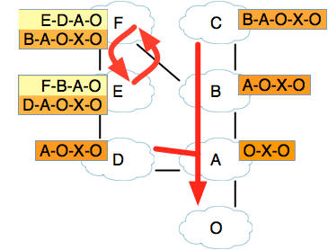
Naive Poisoning Causes Transient Loss
Some ISPs may have working paths that avoid problem ISP X
Naively, poisoning causes path exploration even for these ISPs
Path exploration causes transient loss
AVOID(X,P)
Notes:
Networks start using new routes, but a timer delays their announcements

Slide 105
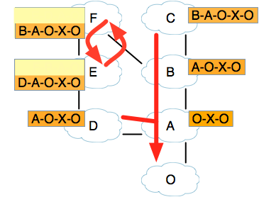
Naive Poisoning Causes Transient Loss
Some ISPs may have working paths that avoid problem ISP X
Naively, poisoning causes path exploration even for these ISPs
Path exploration causes transient loss
AVOID(X,P)
Notes:
E and F announce their new routes to each other, and neither will accept the other, to avoid the loop

Slide 106
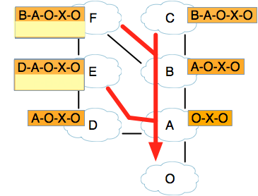
Naive Poisoning Causes Transient Loss
Some ISPs may have working paths that avoid problem ISP X
Naively, poisoning causes path exploration even for these ISPs
Path exploration causes transient loss
AVOID(X,P)
106
Notes:
So then they revert back to their original routes

Slide 107
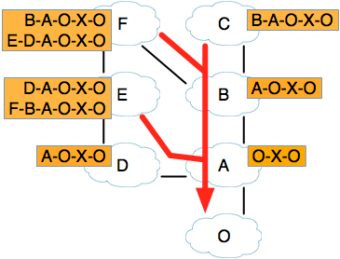
Naive Poisoning Causes Transient Loss
Some ISPs may have working paths that avoid problem ISP X
Naively, poisoning causes path exploration even for these ISPs
Path exploration causes transient loss
AVOID(X,P)

Slide 108
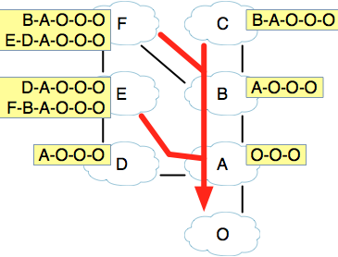
Prepend to Reduce Path Exploration
Most routing decisions based on:
(1) next hop ISP
(2) path length
Keep these fixed to speed convergence
Prepending prepares ISPs for later poison
AVOID(X,P)
Notes:
EXPLAIN PREPEND AS BASELINE

Slide 109
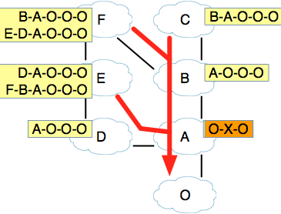
Prepend to Reduce Path Exploration
Most routing decisions based on:
(1) next hop ISP
(2) path length
Keep these fixed to speed convergence
Prepending prepares ISPs for later poison
AVOID(X,P)

Slide 110
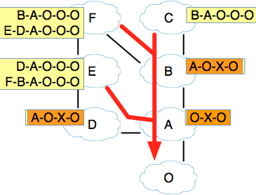
Prepend to Reduce Path Exploration
Most routing decisions based on:
(1) next hop ISP
(2) path length
Keep these fixed to speed convergence
Prepending prepares ISPs for later poison
AVOID(X,P)

Slide 111
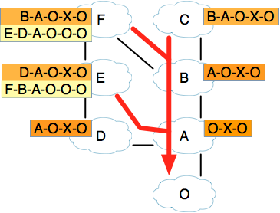
Prepend to Reduce Path Exploration
Most routing decisions based on:
(1) next hop ISP
(2) path length
Keep these fixed to speed convergence
Prepending prepares ISPs for later poison
AVOID(X,P)

Slide 112
Prepend to Reduce Path Exploration
Most routing decisions based on:
(1) next hop ISP
(2) path length
Keep these fixed to speed convergence
Prepending prepares ISPs for later poison
AVOID(X,P)

Slide 113
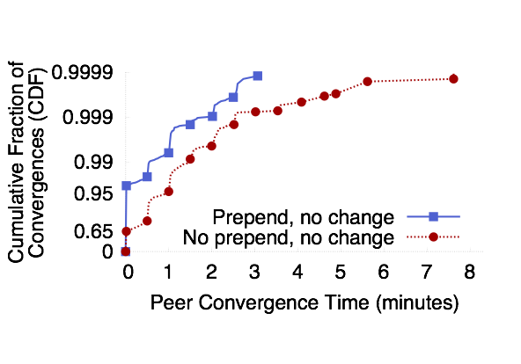
Prepending Speeds Convergence
With no prepend, only 65% of unaffected ISPs converge instantly
With prepending, 95% of unaffected ISPs re-converge instantly, 98%<1/2 min.
Also speeds convergence to new paths for affected peers
Notes:
Test this by announcing actual poisons to real internet using BGPMux
ISPs that were NOT using the path we poisoned
Explain axes - left is converged faster, BGP Collectors
So poisoning usually takes well under a minute.
LIFEGUARD’s failure location usually takes a couple minutes.
EC2 data showed that 80% of unavailability came from outages lasting over 10 minutes.
So LIFEGUARD can generate an automatic response quickly enough to potentially shave off most of that unavailability
Graph shows ISPs that did NOT have to change paths
Also, 60% of cases had loss under 1%, 98% under 2%

Slide 114
LIFEGUARD Summary
We increasingly depend on the Internet, but availability lags
Much of Internet unavailability due to long-lasting outages
LIFEGUARD: Let edge networks reroute around failures
Location challenge: Find problem, given unidirectional failures and tools that depend on connectivity
  Use reverse traceroute, isolate directions, use historical view
Avoidance challenge: Reroute without participation of transit networks
  BGP poisoning gives control to the destination
  Well-crafted announcements ease concerns
Notes:
To improve Internet availability, we need to address long-lasting outages.
Providers should be able to repair failures affecting clients, without relying on action from operators along the path
I sketched how an ISP can locate failures affecting it and what type of BGP announcement they might like to make to take action.
By providing a means to approximate that announcement today, LIFEGUARD enables us to experiment with it and enables ISPs to deploy our approach unilaterally today.

Slide 115
Inter-Domain Routing Summary
BGP4 is the only inter-domain routing protocol currently in use world-wide
Issues?
  Lack of security
  Ease of misconfiguration
  Poorly understood interaction between local policies
  Poor convergence
  Lack of appropriate information hiding
  Non-determinism
  Poor overload behavior

Slide 116
Lots of research into how to fix this
Security
  BGPSEC, RPKI
Misconfigurations, inflexible policy
  SDN
Policy Interactions
  PoiRoot (root cause analysis)
Convergence
  Consensus Routing
Inconsistent behavior
  LIFEGUARD, among others

Slide 117
Why are these still issues?
Backward compatibility
Buy-in / incentives for operators
Stubbornness
Very similar issues to IPv6 deployment

