Slide 1
CS 4700 / CS 5700
Network Fundamentals
Lecture 5: Data Link
(The Cocktail Party Conversation)
Revised 9/14/20

Slide 2
Data Link Layer
Function:
  Send blocks of data (frames) between physical devices
  Regulate access to the physical media
Key challenge:
  How to delineate frames?
  How to detect errors?
  How to perform media access control (MAC)?
  How to recover from and avoid collisions?
Application
Presentation
Session
Transport
Network
Data Link
Physical

Slide 3
Outline
Framing
Error Checking and Reliability
Media Access Control
  802.3 Ethernet
  802.11 Wifi

Slide 4
Logistics
Those in 4700, start looking at Project 3
Project 1 due tomorrow!
Exercise due Thursday 9am
Return to classroom in ONE WEEK
  If you are sick, don’t come. Email the staff email address to get a Zoom link.
  Use K95 or better mask. UHCS has free KN95s. I will bring some to class.
  Nose exposers not tolerated, keep mask on to ask questions

Slide 5
Framing
Physical layer determines how bits are encoded
Next step, how to encode blocks of data
  Packet switched networks
  Each packet includes routing information
  Data boundaries must be known so headers can be read
Types of framing
  Byte oriented protocols
  Bit oriented protocols
  Clock based protocols

Slide 6
Byte Oriented: Sentinel Approach
START
Data
DLE
DLE
DLE
END
END
Add START and END sentinels to the data
Problem: what if END appears in the data?
  Add a special DLE (Data Link Escape) character before END
  What if DLE appears in the data? Add DLE before it.
  Similar to escape sequences in C
    printf(“You must \”escape\” quotes in strings”);
    printf(“You must \\escape\\ forward slashes as well”);
Used by Point-to-Point protocol, e.g. modem, DSL, cellular

Slide 7
Byte Oriented: Byte Counting
132
132
Data
Sender: insert length of the data in bytes at the beginning of each frame
Receiver: extract the length and read that many bytes

Slide 8
Bit Oriented: Bit Stuffing
01111110
Data
01111110
Add sentinels to the start and end of data
  Both sentinels are the same
  Example: 01111110 in High-level Data Link Protocol (HDLC)
Sender: insert a 0 after each 11111 in data
  Known as “bit stuffing”
Receiver: after seeing 11111 in the data…
  111110 → remove the 0 (it was stuffed)
  111111 → look at one more bit
    1111110 → end of frame
    1111111 → error! Discard the frame
Disadvantage: 20% overhead at worst

Slide 9
Clock-based Framing: SONET
Synchronous Optical Network
  Transmission over very fast optical links
  STS-n, e.g. STS-1: 51.84 Mbps, STS-768: 36.7 Gbps
STS-1 frames based on fixed sized frames
  9*90 = 810 bytes
Physical layer details
  Bits are encoded using NRZ
  Payload is XORed with a special 127-bit pattern to avoid long sequences of 0 and 1
90 Columns
Special start pattern
Payload
9 Rows
Overhead
Notes:
Synchronous transport signal (STS)

Slide 10
Outline
Framing
Error Checking and Reliability
Media Access Control
  802.3 Ethernet
  802.11 Wifi

Slide 11
Dealing with Noise
The physical world is inherently noisy
  Interference from electrical cables
  Cross-talk from radio transmissions, microwave ovens
  Solar storms
How to detect bit-errors in transmissions?
How to recover from errors?

Slide 12
Naïve Error Detection
Idea: send two copies of each frame
  if (memcmp(frame1, frame2) != 0) { OH NOES, AN ERROR! }
Why is this a bad idea?
  Extremely high overhead
  Poor protection against errors
    Twice the data means twice the chance for bit errors
  No indication if one or both have errors

Slide 13
Parity Bits
Idea: add extra bits to keep the number of 1s even
  Example: 7-bit ASCII characters + 1 parity bit
0101001
1
1101001
0
1011110
1
0001110
1
0110100
1
10
1
Detects 1-bit errors and some 2-bit errors
Not reliable against bursty errors

Slide 14
Two Dimensional Parity
0101001
1101001
1011110
0001110
0110100
1011111
1
0
1
1
1
0
Parity bit for each row
Parity bit for each column
1111011
0
Parity bit for the parity byte
Can detect all 1-, 2-, and 3-bit errors, some 4-bit errors
14% overhead

Slide 15
Two Dimensional Parity Examples
0101001
1101001
1011110
0001110
0110100
1011111
1
0
1
1
1
0
1
0
Odd number of 1s
1
1
Odd number of 1s
1111011
0
Odd Number of 1s
Odd number of 1s

Slide 16
Checksums
Idea:
  Add up the bytes in the data
  Include the sum in the frame
Use ones-complement arithmetic
Lower overhead than parity: 16 bits per frame
But, not resilient to errors
  Why?
Used in UDP, TCP, and IP
START
Data
Checksum
END
1
0
0101001
+
1101001= 10010010

Slide 17
Cyclic Redundancy Check (CRC)
Uses field theory to compute a semi-unique value for a given message
Much better performance than previous approaches
  Fixed size overhead per frame (usually 32-bits)
  Quick to implement in hardware
  Only 1 in 2³² chance of missing an error with 32-bit CRC
Details are in the book | on Wikipedia

Slide 18
Outline
Framing
Error Checking and Reliability
Media Access Control
  802.3 Ethernet
  802.11 Wifi

Slide 19
What About Reliability?
How does a sender know that a frame was received?
  What if it has errors?
  What if it never arrives at all?
Sender
Receiver
Frame
Time
ACK
Acknowledgement

Slide 20
Stop and Wait
Simplest form of reliability
Example: Bluetooth
Problems?
  Utilization
  Can only have one frame in flight at any time
10Gbps link and 10ms delay
  Need 100 Mbit to fill the pipe
  Assume packets are 1500B
1500B*8bit/(2*10ms) = 600Kbps
Utilization is 0.006%
Sender
Receiver
Frame
Timeout
ACK
Frame
Timeout
Frame

Slide 21
Sliding Window
Allow multiple outstanding, un-ACKed frames
Number of un-ACKed frames is called the window
Sender
Receiver
Frames
Window
ACKs
Made famous by TCP
  We’ll look at this in more detail later

Slide 22
Should We Error Check in the Data Link?
Recall the End-to-End Argument
Cons:
  Error free transmission cannot be guaranteed
  Not all applications want this functionality
  Error checking adds CPU and packet size overhead
  Error recovery requires buffering
Pros:
  Potentially better performance than app-level error checking
Data link error checking in practice
  Most useful over lossy links
  Wifi, cellular, satellite

Slide 23
Outline
Framing
Error Checking and Reliability
Media Access Control (STOP?)
  802.3 Ethernet
  802.11 Wifi

Slide 24
What is Media Access?
Ethernet and Wifi are both multi-access technologies
  Broadcast medium, shared by many hosts
  Simultaneous transmissions cause collisions
    This destroys the data
Media Access Control (MAC) protocols are required
  Rules on how to share the medium
  Strategies for detecting, avoiding, and recovering from collisions

Slide 25
Strategies for Media Access
Channel partitioning
  Divide the resource into small pieces
  Allocate each piece to one host
  Example: Time Division Multi-Access (TDMA) cellular
  Example: Frequency Division Multi-Access (FDMA) cellular
Taking turns
  Tightly coordinate shared access to avoid collisions
  Example: Token ring networks
Contention
  Allow collisions, but use strategies to recover
  Examples: Ethernet, Wifi

Slide 26
Contention MAC Goals
Share the medium
  Two hosts sending at the same time collide, thus causing interference
  If no host sends, channel is idle
  Thus, want one user sending at any given time
High utilization
  TDMA is low utilization. WHY?
  Just like a circuit switched network
Simple, distributed algorithm
  Multiple hosts that cannot directly coordinate
  No fancy (complicated) token-passing schemes

Slide 27
Contention Protocol Evolution
ALOHA
  Developed in the 70’s for packet radio networks
Slotted ALOHA
  Start transmissions only at fixed time slots
  Significantly fewer collisions than ALOHA
Carrier Sense Multiple Access (CSMA)
  Start transmission only if the channel is idle
CSMA / Collision Detection (CSMA/CD)
  Stop ongoing transmission if collision is detected

Slide 28
ALOHA
Topology: radio broadcast with multiple stations
Protocol:
  Stations transmit data immediately
  Receivers ACK all packets
  No ACK = collision, wait a random time then retransmit
Simple, but radical concept
Previous attempts all divided the channel
  TDMA, FDMA, etc.
Optimized for the common case: few senders
A
B
C

Slide 29
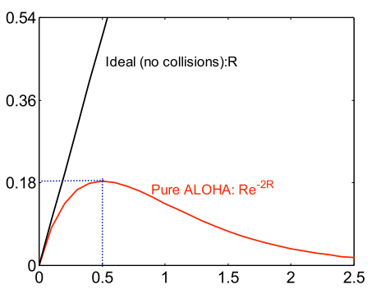
Tradeoffs vs. TDMA
In TDMA, each host must wait for its turn
  Delay is proportional to number of hosts
In Aloha, each host sends immediately
  Much lower delay
  But, much lower utilization
2*Frame_Width
Throughput
Sender A
ALOHA Frame
Sender B
ALOHA Frame
Time
  Maximum throughput is ~18% of channel capacity
Load

Slide 30
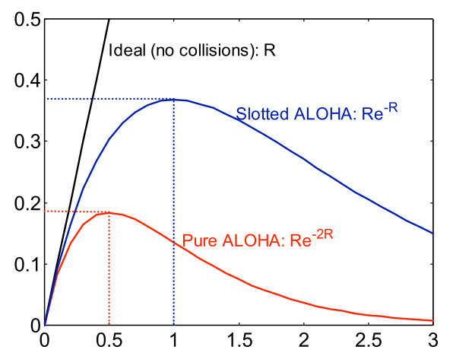
Slotted ALOHA
Protocol
  Same as ALOHA, except time is divided into slots
  Hosts may only transmit at the beginning of a slot
Thus, frames either collide completely, or not at all
  37% throughput vs. 18% for ALOHA
  But, hosts must have synchronized clocks
Throughput
Load

Slide 31
Outline
Framing
Error Checking and Reliability
Media Access Control (STOP?)
  802.3 Ethernet
  802.11 Wifi

Slide 32
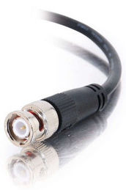

Broadcast Ethernet
Originally, Ethernet was a broadcast technology
Terminator
10Base2
Repeater
Tee Connector
Hubs and repeaters are layer-1 devices, i.e. physical only
10BaseT and 100BaseT
T stands for Twisted Pair
Hub

Slide 33
802.3 Ethernet
Bytes
7
1
6
6
2
0-1500
0-46
4
Preamble
SF
Source
Dest.
Length
Data
Pad
Checksum
Preamble is 7 bytes of 10101010. Why?
Start Frame (SF) is 10101011
Source and destination are MAC addresses
  E.g. 00:45:A5:F3:25:0C
  Broadcast: FF:FF:FF:FF:FF:FF
Minimum packet length of 64 bytes, hence the pad

Slide 34
CSMA/CD
Carrier sense multiple access with collision detection
Key insight: wired protocol allows us to sense the medium
Algorithm
  Sense for carrier
  If carrier is present, wait for it to end
    Sending would cause a collision and waste time
  Send a frame and sense for collision
  If no collision, then frame has been delivered
  If collision, abort immediately
    Why keep sending if the frame is already corrupted?
  Perform exponential backoff then retransmit

Slide 35
CSMA/CD Collisions
Spatial Layout of Hosts
Collisions can occur
Collisions are quickly detected and transmission terminates
Note the role of distance, propagation delay, and frame length
A
B
C
D
t₀
t₁
Time
Detect Collision and Halt

Slide 36
Exponential Backoff
When a sender detects a collision, send “jam signal”
  Make sure all hosts are aware of collision
  Jam signal is 32 bits long (plus header overhead)
Exponential backoff operates in multiples of 512 bits
  Select k ∈ [0, 2^{n} – 1], where n = number of collisions
  Wait k * 51.2µs before retransmission
  n is capped at 10, frame dropped after 16 collisions
Backoff time is divided into contention slots
Remember this number

Slide 37
Minimum Packet Sizes & Cable Length
Why is the minimum packet size 64 bytes?
  To give hosts enough time to detect collisions
What is the relationship between packet size and cable length?
  Time t: Host A starts transmitting
  Time t + d: Host B starts transmitting
  Time t + 2*d: Host A detects the collision
A
B
Propagation Delay (d)
A
B

Slide 38
Exercise
Derive the maximum cable length
  Min frame size: b
  Bandwidth: r
  Cable length: l
  Propagation delay: d
  Speed of light (xmit one bit): c
A
B
  Time t + 2*d: Host A detects the collision
  Must transmit bits for longer than 2*d
Propagation Delay (d)
A
B

Slide 39
Minimum Packet Sizes
Why is the minimum packet size 64 bytes?
  To give hosts enough time to detect collisions
What is the relationship between packet size and cable length?
10 Mbps Ethernet
Packet and cable lengths change for faster Ethernet standards
  Time t: Host A starts transmitting
  Time t + d: Host B starts transmitting
  Time t + 2*d: collision detected
A
B
Propagation Delay (d)
min_frame_size*light_speed/(2*bandwidth) = max_cable_length
(64B*8)*(2.5*10⁸mps)/(2*10⁷bps) = 6400 meters

Slide 40
Cable Length Examples
min_frame_size*light_speed/(2*bandwidth) = max_cable_length
(64B*8)*(2.5*10⁸mps)/(2*10Mbps) = 6400 meters
What is the max cable length if min packet size were changed to 1024 bytes?
  102.4 kilometers
What is max cable length if bandwidth were changed to 1 Gbps ?
  64 meters
What if you changed min packet size to 1024 bytes and bandwidth to 1 Gbps?
  1024 meters

Slide 41
Exponential Backoff, Revisited
Remember the 512 bit backoff timer?
Minimum Ethernet packet size is also 512 bits
  64 bytes * 8 = 512 bits
Coincidence? Of course not.
  If the backoff time was <512 bits, a sender who waits and another who sends immediately can still collide

Slide 42
Maximum Packet Size
Maximum Transmission Unit (MTU): 1500 bytes
Pros:
  Bit errors in long packets incur significant recovery penalty
Cons:
  More bytes wasted on header information
  Higher per packet processing overhead
Datacenters shifting towards Jumbo Frames
  9000 bytes per packet

Slide 43
Long Live Ethernet
Today’s Ethernet is switched
  More on this later
1Gbit and 10Gbit Ethernet now common
  100Gbit on the way
  Uses same old packet header
  Full duplex (send and receive at the same time)
  Auto negotiating (backwards compatibility)
  Can also carry power

Slide 44
Outline
Framing
Error Checking and Reliability
Media Access Control
  802.3 Ethernet
  802.11 Wifi

Slide 45
802.3 vs. Wireless
Ethernet has one shared collision domain
  All hosts on a LAN can observe all transmissions
Wireless radios have small range compared to overall system
  Collisions are local
  Collision are at the receiver, not the sender
  Carrier sense (CS in CSMA) plays a different role
802.11 uses CSMA/CA not CSMA/CD
  Collision avoidance, rather than collision detection

Slide 46
Hidden Terminal Problem
Radios on the same network cannot always hear each other
Collision!
A
B
C
A cannot hear C
C cannot hear A
Hidden terminals mean that sender-side collision detection is useless

Slide 47
Exposed Terminal Problem
Carrier sense detects a busy channel
Carrier sensing is problematic in wireless
No collision
No collision
A
B
C
D
Carrier sense can erroneously reduce utilization

Slide 48
Reachability in Wireless
High level problem:
  Reachability in wireless is not transitive
  Just because A can reach B, and B can reach C, doesn’t mean A can reach C
A
B
C
D

Slide 49
MACA
Multiple Access with Collision Avoidance
  Developed in 1990
Sense the channel
The receiver is busy
Channel is idle
Host in
Sender’s
Range
Host in
Receiver’s
Range
Sender
Receiver
Soft-reserve the channel
RTS
RTS
CTS
CTS
RTS but no CTS = clear to send
Data
Data
Successful transmission
ACK
ACK

Slide 50
Collisions in MACA
What if sender does not receive CTS or ACK?
  Assume collision
  Enter exponential backoff mode

Slide 51
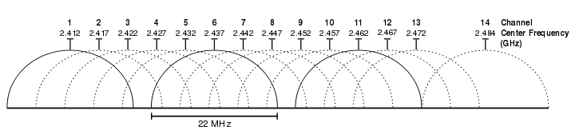
802.11b
802.11
  Uses CSMA/CA, not MACA
802.11b
  Introduced in 1999
  Uses the unlicensed 2.4 Ghz band
    Same band as cordless phones, microwave ovens
  Complementary code keying (CCK) modulation scheme
  5.5 and 11 Mbps data rates
    Practical throughput with TCP is only 5.9 Mbps
  11 channels (in the US). Only 1, 6, and 11 are orthogonal

Slide 52
802.11a/g
802.11a
  Uses the 5 Ghz band
  6, 9, 12, 18, 24, 36, 48, 54 Mbps
  Switches from CCK to Orthogonal Frequency Division Multiplexing (OFDM)
    Each frequency is orthogonal
802.11g
  Introduced in 2003
  Uses OFDM to improve performance (54 Mbps)
  Backwards compatible with 802.11b
    Warning: b devices cause g networks to fall back to CCK

Slide 53
802.11n/ac/ax
802.11n
  Introduced in 2009
  Multiple Input Multiple Output (MIMO)
    Multiple send and receive antennas per devices (up to four)
    Data stream is multiplexed across all antennas
  Maximum 600 Mbps transfer rate (in a 4x4 configuration)
  300 Mbps is more common (2x2 configuration)
802.11ac (January 2014)
  8x8 MIMO in the 5 GHz band, 500 Mbps – 1 GBps rates
802.11ax (expected to be standardized September 2020)
  better power-control, OFDMA, higher order 1024-QAM, MIMO and MU-MIMO
  Up to 11Gbps, improved latency

Slide 54
802.11 Media Access (Start here!)
MACA-style RTS/CTS is optional
Distributed Coordination Function (DCF) based on…
  Inter Frame Spacing (IFS)
    DIFS – low priority, normal data packets
    PIFS – medium priority, used with Point Coordination Function (PCF)
    SIFS – high priority, control packets (RTS, CTS, ACK, etc.)
  Contention interval: random wait time
Sense the channel
DIFS
PIFS
Sense the channel
SIFS
Channel Busy
Contention
Transmit Data
Sender
Time

Slide 55
802.11 DCF Example
Sense the channel
Sense the channel
Sense the channel
SIFS
Channel Busy
Transmit Data
Sender 1
PIFS
Channel Busy
Contention
Sender 2
DIFS
Sender 3
Time
Sense the channel

Slide 56
801.11 is Complicated
We’ve only scratched the surface of 802.11
  Association – how do clients connect to access points?
    Scanning
    What about roaming?
  Variable sending rates to combat noisy channels
  Infrastructure vs. ad-hoc vs. point-to-point
    Mesh networks and mesh routing
  Power saving optimizations
    How do you sleep and also guarantee no lost messages?
  Security and encryption (WEP, WAP, 802.11x)
This is why there are courses on wireless networking

