Slide 1
CS 4700/5700
Fundamentals of Computer Networks
Lecture 1: Logistics
(a.k.a., setting the ground rules)

Slide 2
Hello!
Welcome to CS 5700
  Are you in the right classroom?
  Okay, good.
Who am I?
  Professor David Choffnes
  My research covers nearly all aspects of networking, recent focus on privacy/security and net neutrality
  choffnes@ccs.neu.edu
  Drop-in hours (Zoom or ISEC 613): 3-4pm Tuesdays (or by appt)

Slide 3
My background
Before professoring
  BA in Physics and French -> CS textbook author -> PhD in CS (Networks/DS) -> postdoc
  Research focused car-to-car networks, P2P systems, crowdsourcing
Since joining Northeastern
  Focus on privacy, security, transparency, and mobile systems
  Topics include mobile/IoT privacy, PKIs, net neutrality, congestion control
Sabbatical
  Security architect at Akamai, focusing on Internet routing performance and security

Slide 4
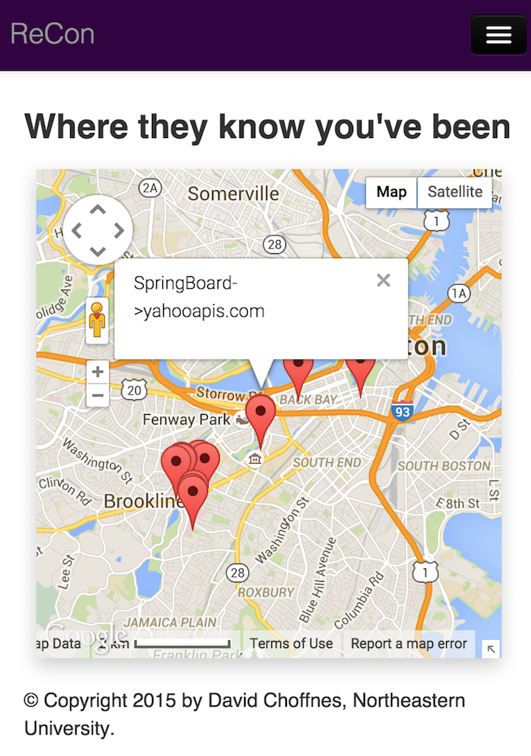
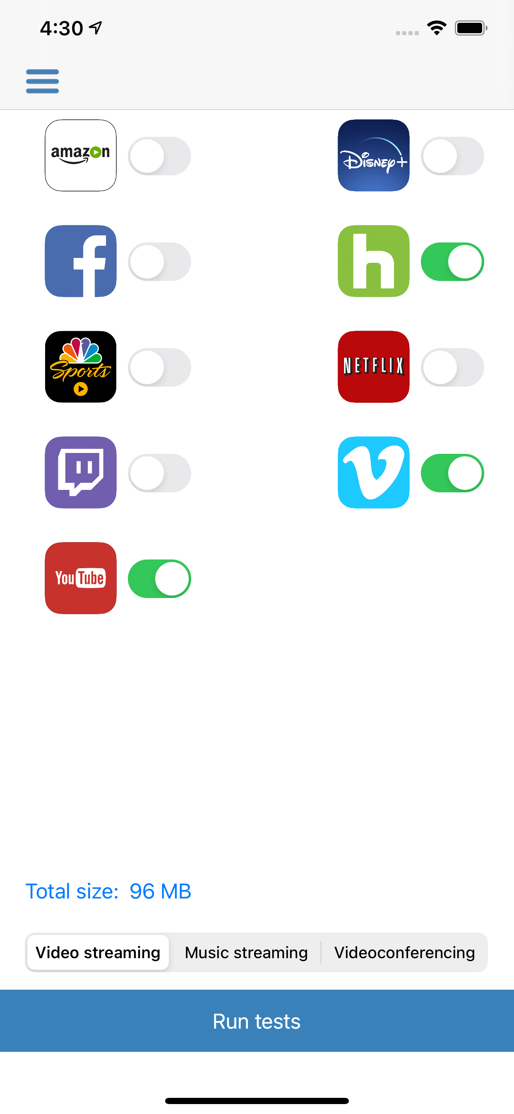
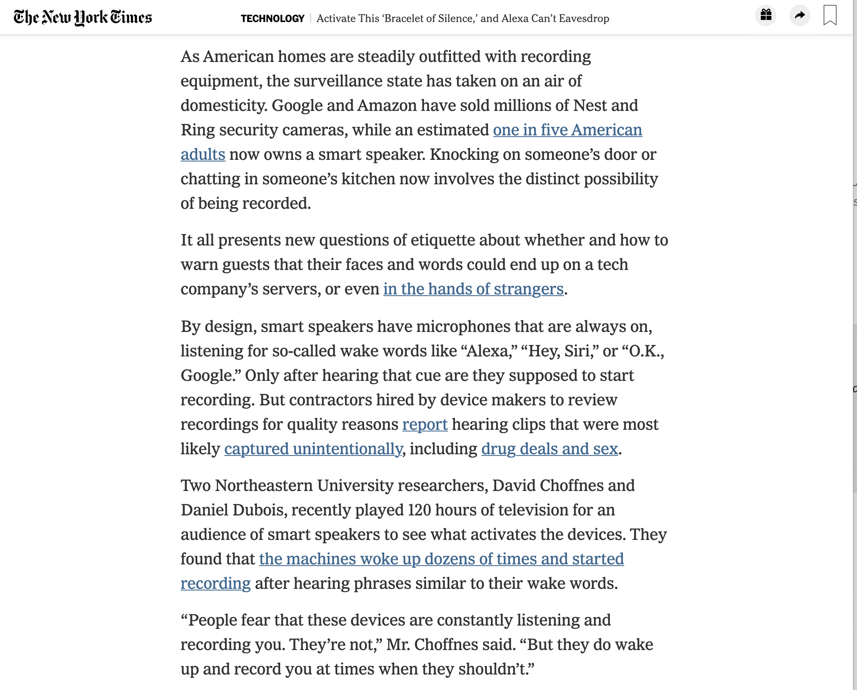
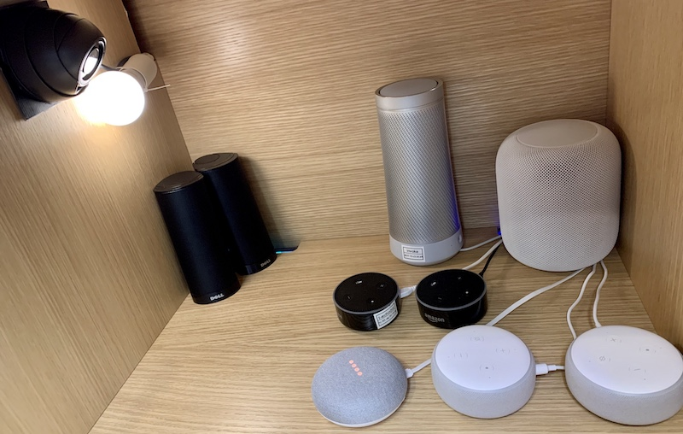
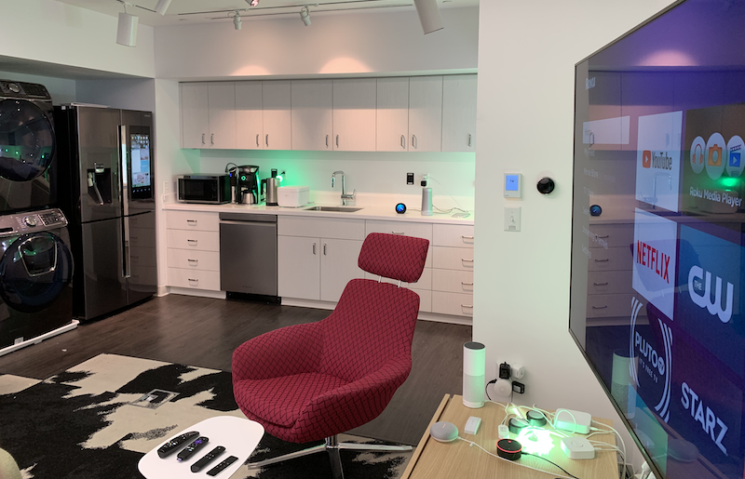
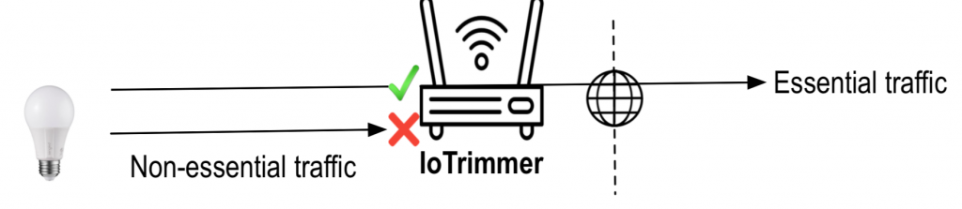
Example projects

Slide 5
Anti-Social Media
I’m a privacy researcher, please respect my privacy
  It’s nothing personal
  I need to practice what I preach
  Extremely small social media presence, treated as a public forum
Follow me on Twitter: @proffnes
  Pure, unadulterated self-promotion
  Also: Good place to learn about research updates
LinkedIn: I probably won’t add you, so please don’t ask
  Unless your CRUSH the course!
  Or we do research together

Slide 6
Your TAs
TAs
  Marwa Elali
  Eysa Lee
  Tanay Mehra
  Contact
    cs5700f22-staff@ccs.neu.edu
    Piazza
  Office Hours: Posted on Canvas (Zoom)

Slide 7
Like it’s 2019 again
In person lectures
  If you have any symptoms, let me know and I will do a hybrid lecture with Zoom
  Expectation is that vast majority of students will be in class
Drop-in hours via Zoom or in person (links in Canvas)
  May switch to only of these if it’s a management issue

Slide 8
Why Take This Course?
How are we even able to have classes during a pandemic?
How many of you have checked your e-mail, social, texts…
  Today?
  In the past hour?
  Since I started talking?

Slide 9




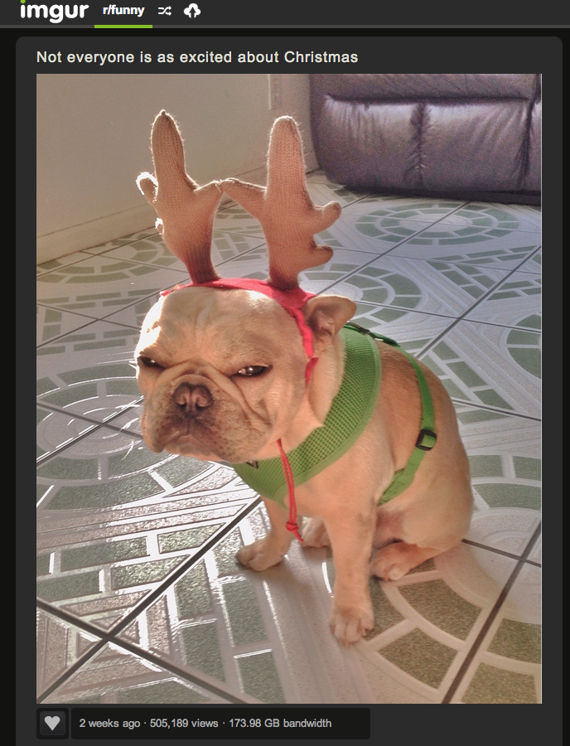

Computer networks are ubiquitous
Networks touch every part of our daily life
  Videoconferencing
  Web search
  Social networking
  Watching movies
  Ordering merchandise
  Wasting time

Slide 10
Computer networks are ubiquitous
Networking is one of the most critical topics in CS
There would be no…
  Big Data
  Cloud
  Apps or Mobile Computing
  Streaming video
  WoW, Minecraft, Pokemon GO, …
  Social Networks
  NUFlex
  …
… without networks

Slide 11
Goals
Fundamental understanding about computer networks
  All the way from bits on a wire…
  … across the ever-evolving Internet…
  … to a distributed applications
Focus on software and protocols
  Not hardware
  Minimal theory
Project-centric, hands on experience
  Programming APIs
  Network Simulation
  Application-level protocols
  Distributed systems

Slide 12
Online Resources
Course website
  https://david.choffnes.com/classes/cs5700f22/
Class forum is on Piazza
  Sign up today via Canvas
When in doubt, post to Piazza
  Piazza is preferable to email
    If you e-mail me a question, I will tell you to post it on Piazza
  Use folders (homework1, lecture2, project3, etc.)

Slide 13
Teaching Style
I am a network researcher
  Things make sense to me that may not make sense to you
  I talk fast if nobody stops me
Solution: ask/answer questions!
  Seriously, ask questions (interrupting me is OK!)
  Staring at blank faces in class is very awkward
    I will continue doing so until someone answers my questions

Slide 14

Textbook
Optional textbook
  Computer Networks: A Systems Approach (Peterson and Davie, 5th Edition)
  5th Edition free online via library or author’s website: https://subjectguides.lib.neu.edu/compsci.

Slide 15
Workload
Exams | Midterm (15%), Final (20%)
Projects (4) | 7%, 11%, 19%, 23%
Exercises/ Participation | 5%

Slide 16
Projects
This course is project-centric
  Designed to give you real networking experience
  Start early!
  Seriously, start early!
4 projects
  Due at 11:59:59pm on Wednesday of specified week
  Use Gradescope to submit your code, documentation, etc.
  Working code is critical

Slide 17
Project Logistics
Languages
  You may choose the language for the projects
    Code must compile on the Gradescope docker instances (Ubuntu 20.04)
Project 1 is out, due September 28th
  Individual project (no teams)
Project questions?
  Post them on Piazza!

Slide 18
Project Groups
Projects will be completed in groups of two (except Projects 1 and 2)
  Unless we have odd numbers…
Partner selection
  Pick whoever you want
  You may switch partners between projects
  Do not complain to me about your lazy partner
    Hey, you picked them
Can’t find a partner?
  Post a message on Piazza!

Slide 19
Late Policy
Each student is given 6 slip days that they can use at any time to extend a deadline
  You don’t need to ask me, just turn-in stuff late
  All group members must have unused slip days
    i.e. if one member has zero slip days left, the whole group is late
Assignments are due at 11:59:59, no exceptions
  1 second late = 1 hour late = 1 day late
  20% off per day late

Slide 20
Paper Reading
You will read lots of papers in this class
  Some are classics, foundations of existing networks
  Others propose newer, more advanced designs
List of papers are on the website [Expect some updates over the semester]
  2 papers in first week, vote to pick paper in subsequent weeks
  If you have questions about them, ask on Piazza
Exercise each week: answer discussion questions about the reading
  Due by 9am Thursday the week it is listed
  So you have some reading to do for next week
Questions about these papers will be covered during in-class exercises

Slide 21
Paper Discussion Plan
I will present a discussion prompt
  Form groups of 2 to respond to the prompt
  I will randomly pick groups to present their answers
This is a grad-level course
  I’m not taking attendance
  …but you will want to show up
  Participation in these exercises is 5% of your grade

Slide 22
In Class Participation
In-class exercises:
  Meant to test knowledge of papers, reinforce concepts
  During some lectures I will post exercises on Canvas
  Exercises will mimic exam question style
    Points awarded only to students who complete exercises
    At least one group will be asked to present their answer
  This will account for most of the participation grade

Slide 23
Exams
Midterm and Final
  Midterm during class
  Final during finals week
  The final will be cumulative
All exams are:
  Closed book
  One-page “cheat sheet” allowed
Guessing is strongly discouraged
  You get 20% of points for leaving a question blank
  0% if you have both a right answer and a wrong answer

Slide 24
Final Grades
At the end of the semester, all of your grades will sum to 100 points
  15+ 20 + 7 + 11 + 19 + 23 + 5 =100
Final grades are based on a simple scale:
  A >92, A- 90-92, B+ 87-89, B 83-86, B- 80-82, …
I don’t curve grades
Exams
Projects
Participation

Slide 25
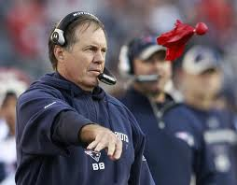
Grade Changes
Each student gets two challenges
  Modeled after NFL system
  If you ask for a regrade and you are wrong, you lose a challenge
  When you are out of challenges, you cannot ask for regrading
Must write email to the staff email address:
  Specify the problem(s) you want regraded
  For each problem, explain why the grade is in error
Don’t sweat the small stuff
  Regrading minor errors does not make me a happy Professor
  If the change is <5% of the grade, don’t bother
More details on the website

Slide 26
Cheating
Do not do it
  Seriously, don’t make me say it again
Cheating is an automatic zero
  I will send any and all suspects to OSCCR without exception
  Khoury is also tracking cheating, with stricter enforcement
Project code must be original
  You and your groupmates only
    Unless we give you starter code, obviously
  StackOverflow/Quora are not your friends
  Copying from public Githubs, using Copilot will get you an F grade
  If you have questions about an online resource, ask us

Slide 27
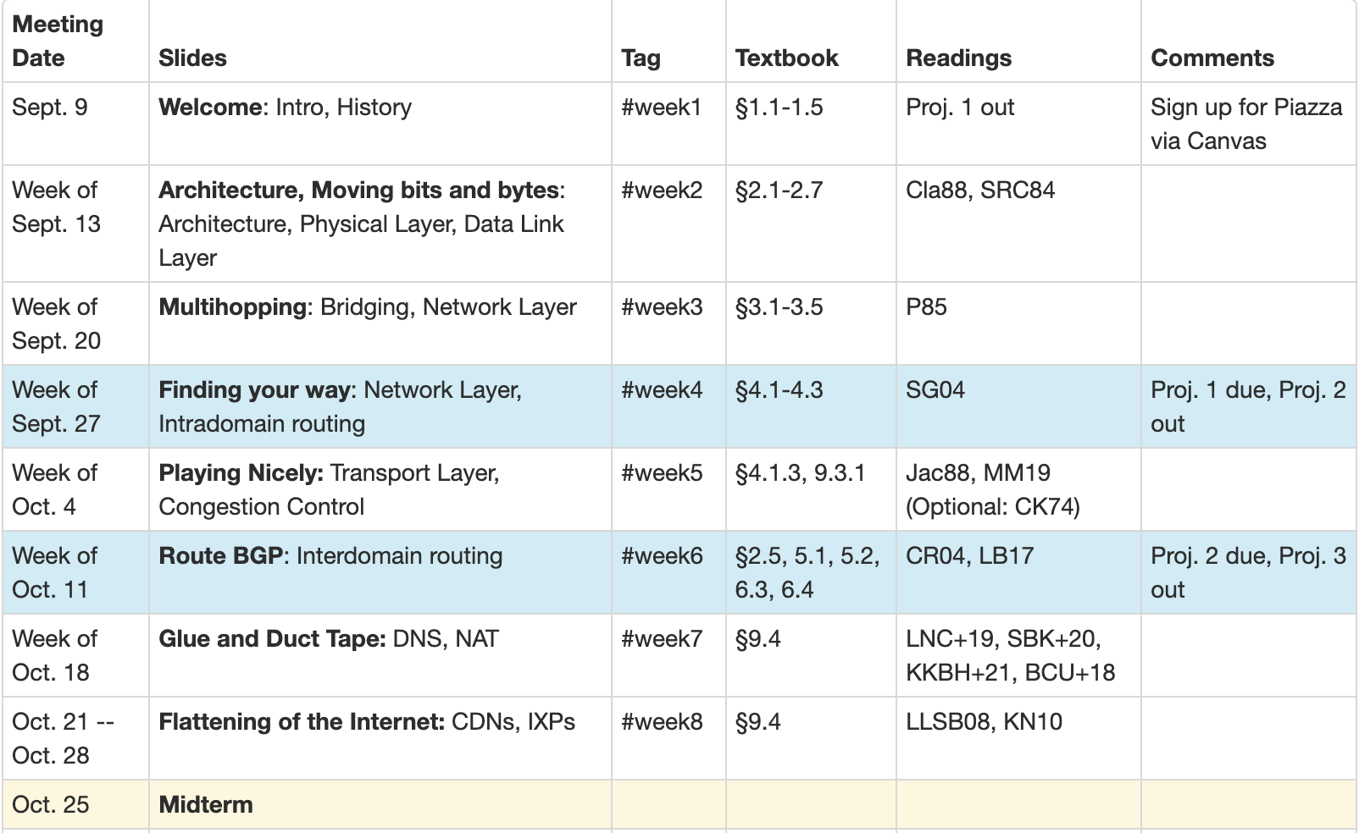
Schedule Overview

Slide 28
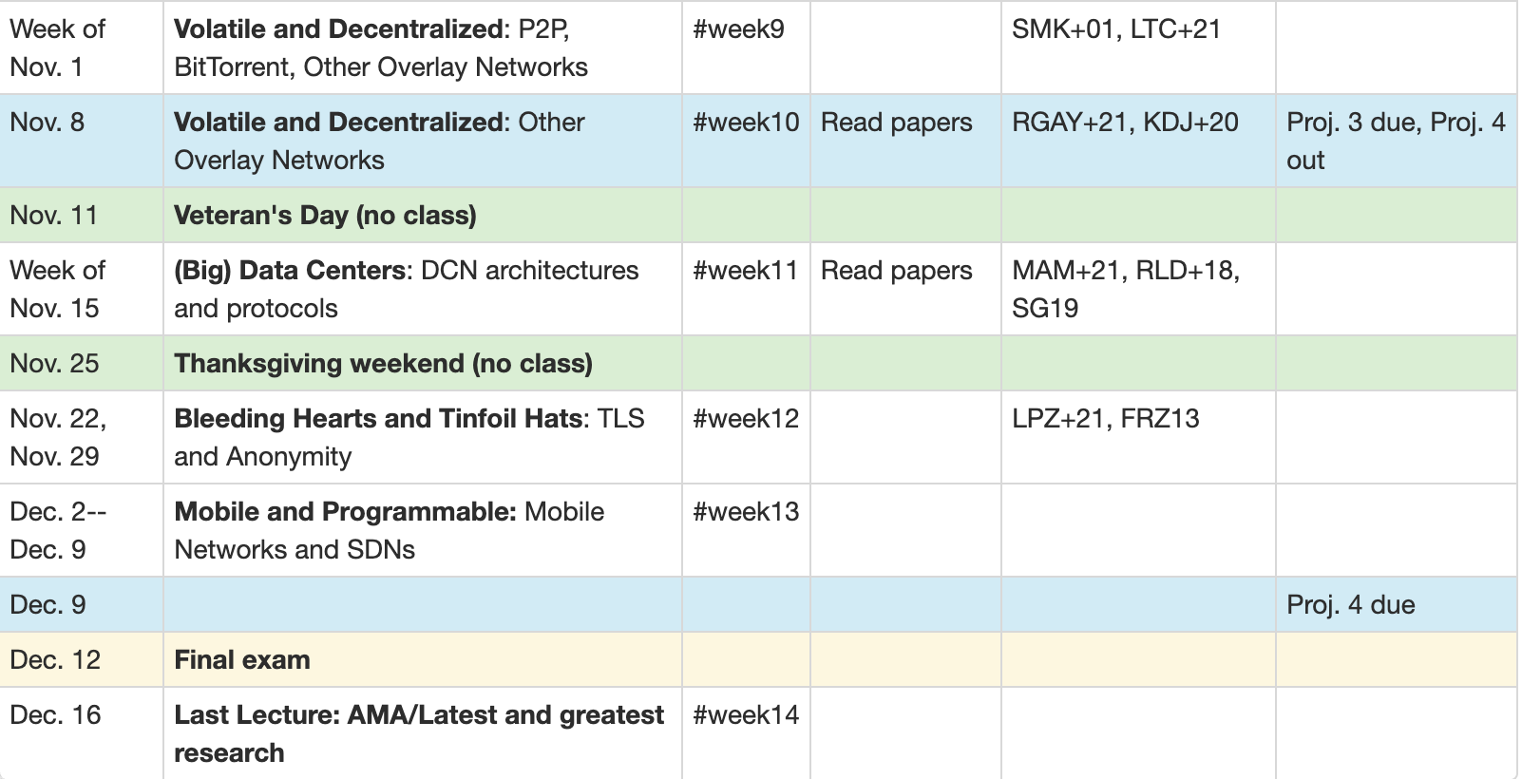
Schedule Overview
Last lecture most likely will be about new research
  Probably something I worked on

Slide 29
Questions?

Slide 30
One last note
Please take care of yourselves and each other
  Seek help if you need it (UHCS, WeCare, etc)
  My (virtual) door is always open

