Slide 1
Logistics
Welcome back!
Exercise 7 posted, due Thursday
Project 4 well under way
Today: hints for Project 5 (among other things)

Slide 2
CS 4700 / CS 5700
Network Fundamentals
Lecture 13: Content Delivery Networks
(Over 1 billion served … each minute)
Revised 03/14/2021

Slide 3
Outline
Motivation
CDN basics
Prominent example: Akamai

Slide 4
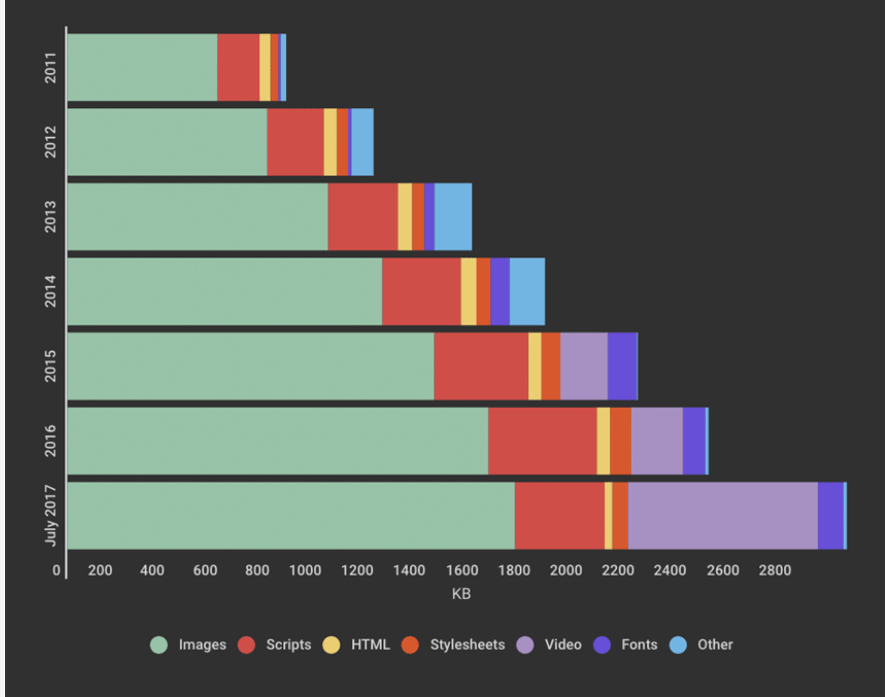
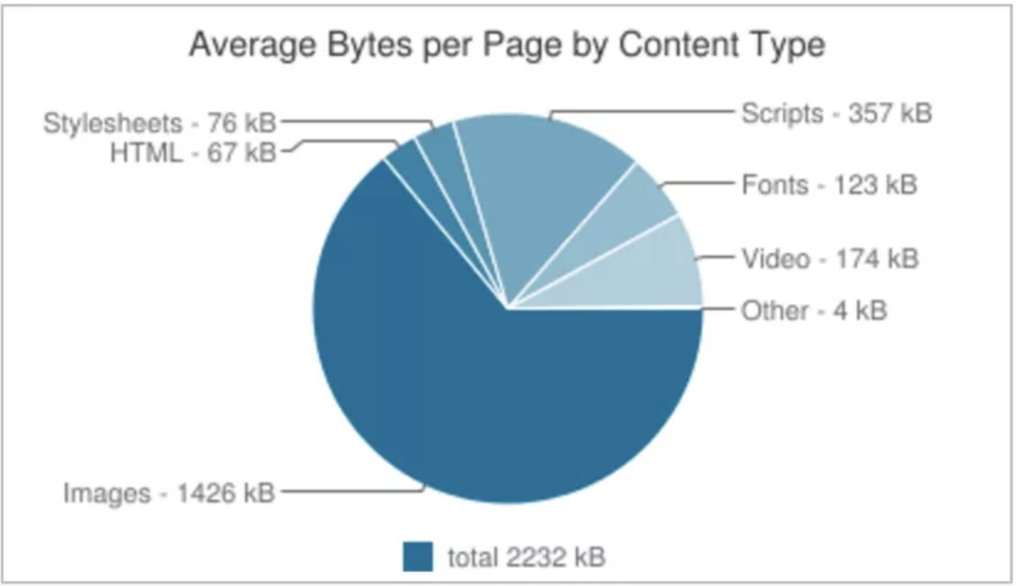
Content in today’s Internet
Most flows are HTTP
  Web is at least 13% of traffic (video is 60+%)
  Average object size is varies, but 10s to 100s of KB
HTTP uses TCP, so it will
  Be ACK clocked
  For text objects, likely never leave slow start
  For video objects, startup delays while ramping up
Is the Internet designed for this common case?
  Why?

Slide 5
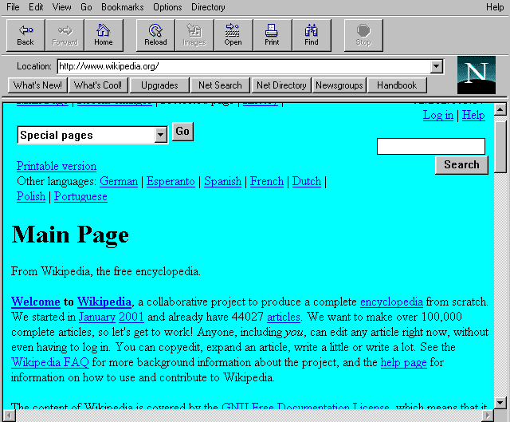
Evolution of Serving Web Content
In the beginning…
  …there was a single server
  Probably located in a closet
  And it probably served blinking text
Issues with this model
  Site reliability
    Unplugging cable, hardware failure, natural disaster
  Scalability
    Flash crowds (aka Slashdotting, Reddit hug, …)

Slide 6

Replicated Web service
Internet
Use multiple servers
Advantages
  Better scalability
  Better reliability
Disadvantages
  How do you decide which server to use?
  How to do synchronize state among servers?

Slide 7
Load Balancers
Internet
Device that multiplexes requests
across a collection of servers
  All servers share one public IP
  Balancer transparently directs requests
  to different servers
How should the balancer assign clients to servers?
  Random / round-robin
    When is this a good idea?
  Load-based
    When might this fail?
Challenges
  Scalability (must support traffic for n hosts)
  State (must keep track of previous decisions)
    RESTful APIs reduce this limitation

Slide 8
Load balancing: Are we done?
Advantages
  Allows scaling of hardware independent of IPs
  Relatively easy to maintain
Disadvantages
  Expensive
  Still a single point of failure
  Location!
Where do we place the load balancer for Wikipedia?

Slide 9
Popping up: HTTP performance
For Web pages
  RTT matters most
  Where should the server go?
For video
  Available bandwidth matters most
  Where should the server go?
Is there one location that is best for everyone?

Slide 10
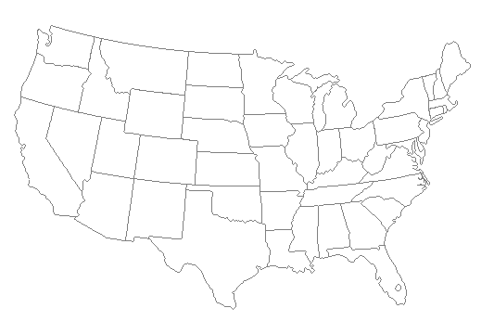
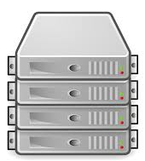
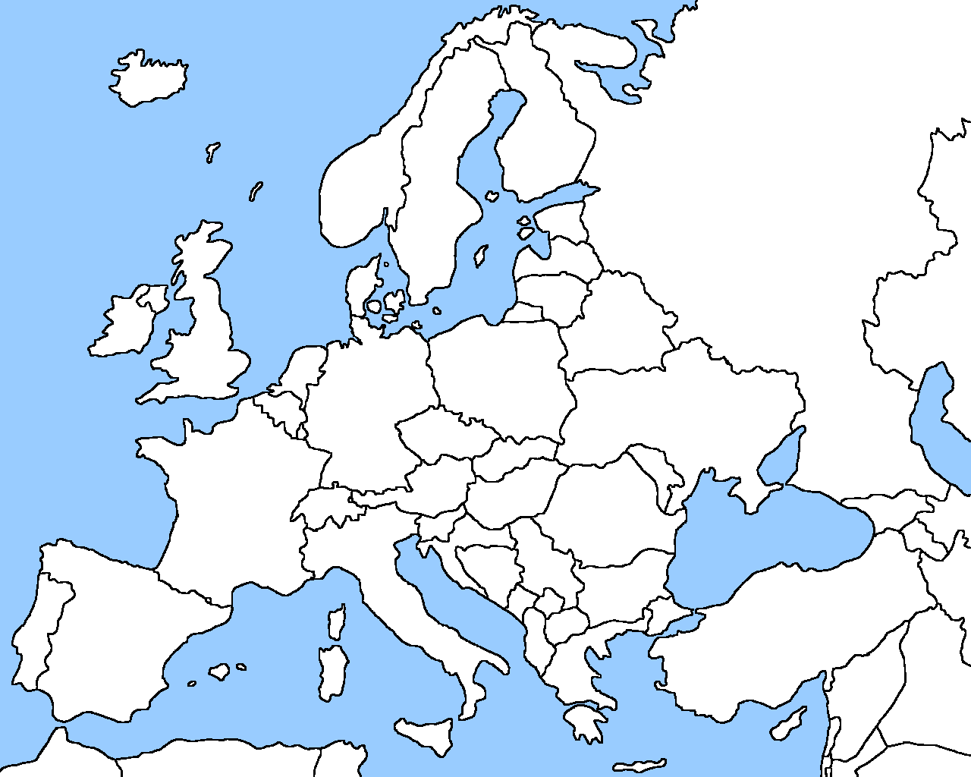
Server placement

Slide 11
Why speed matters
Impact on user experience
  Users navigating away from pages
  Video startup delay

Slide 12

Why speed matters
Impact on user experience
  Users navigating away from pages
  Video startup delay
Impact on revenue
  Amazon: increased revenue 1% for every 100ms reduction in PLT
  Shopzilla:12% increase in revenue by reducing PLT from 6 seconds to 1.2 seconds
Ping from BOS to LAX: ~90-100ms

Slide 13
Strawman solution: Web caches
ISP uses a middlebox that caches Web content
  Better performance – content is closer to users
  Lower cost – content traverses network boundary once
  Does this solve the problem?
No!
  Size of all Web content is too large
    Zipf distribution limits cache hit rate
  Web content is dynamic and customized
    Can’t cache banking content
    What does it mean to cache search results?

Slide 14
Outline
Motivation
CDN basics
Prominent example: Akamai

Slide 15
What is a CDN?
Content Delivery Network
  Also sometimes called Content Distribution Network
  At least half of the world’s bits are delivered by a CDN
    Probably closer to 70/80%
Primary Goals
  Create replicas of content throughout the Internet
  Ensure that replicas are always available
  Direct clients to replicas that should give good performance

Slide 16
Key Components of a CDN
Distributed servers
  Usually located inside of other ISPs
  Often located in IXPs (coming up later...)
High-speed network connecting them
Clients (eyeballs)
  Can be located anywhere in the world
  They want fast Web performance
Glue
  Something that binds clients to “nearby” replica servers

Slide 17

Key CDN Components
17

Slide 18
Examples of CDNs
Akamai
  147K+ servers, 1200+ networks, 650+ cities, 92 countries
Limelight
  Well provisioned delivery centers, interconnected via a private fiber-optic connected to 700+ access networks
Verizon Media
  30+ PoPs, 5 continents, 2000+ direct connections
Others
  Google, Facebook, Amazon, AT&T, Level3, Brokers

Slide 19
Examples of CDNs (~2019)
Akamai
  250K+ servers, 1500+ networks, 650+ cities, 110+ countries, every continent, ~25% of all web traffic
Limelight
  ~80 well-provisioned delivery centers, interconnected via a private fiber-optic network, connected to 900+ networks
CDNetworks
  169 Point of Presence (PoPs) on six continents, with over 30 locations in Russia and China
Others (incl Private and Telco)
  Google, Facebook, Apple, Netflix, MS, AWS, AT&T, Level3, EdgeCast

Slide 20
Servers: Inside a CDN
Servers are deployed in clusters for reliability
  Some may be offline
    Could be due to failure
    Also could be “suspended” (e.g., to save power or for upgrade)
Could be multiple clusters per location (e.g., in multiple racks)
Server locations
  Well-connected points of presence (PoPs)
  Inside of ISPs

Slide 21
Mapping clients to servers
CDNs need a way to send clients to the “best” server
  The best server can change over time
  And this depends on client location, network conditions, server load, …
  What existing technology can we use for this?
DNS-based redirection
  Clients request www.foo.com
  DNS server directs client to one or more IPs based on request IP
  Use short TTL to limit the effect of caching

Slide 22
Mapping: CDN redirection example
$ dig a2.espncdn.com
;; QUESTION SECTION:
;a2.espncdn.com. IN A
;; ANSWER SECTION:
a2.espncdn.com. 110 IN CNAME a2.espncdn.com.edgesuite.net.
a2.espncdn.com.edgesuite.net. 110 IN CNAME a1830.g1.akamai.net.
a1830.g1.akamai.net. 8 IN A 18.2.197.81
a1830.g1.akamai.net. 8 IN A 18.2.197.73

Slide 23

DNS Redirection Considerations
Advantages
  Uses existing, scalable DNS infrastructure
  URLs can stay essentially the same
  TTLs can control “freshness”
Limitations
  DNS servers see only the DNS server IP
    Assumes that client and DNS server are close. Is this accurate?
  Small TTLs are often ignored
  Content owner must give up control
  Unicast addresses can limit reliability

Slide 24
Mapping: Using Anycast
Anycast address
  An IP address in a prefix
  announced from multiple
  locations
120.10.0.0/16
AS 41
AS 32
AS 31
120.10.0.0/16
AS 20
AS 3
AS 1
AS 2
?

Slide 25
Anycasting Considerations
Why do anycast?
  Simplifies network management
    Replica servers can be in the same network domain
  Uses best BGP path
Disadvantages
  BGP path may not be optimal
  Stateful services can be complicated
  Catchments (clients mapped to an anycast site) may vary over time
  Fine-tuning is challenging

Slide 26
Optimizing Performance (aka Project 5 hints)
Key goal
Send clients to server with best end-to-end performance
Performance depends on
  Server load
  Content at that server
  Network conditions
Optimizing for server load
  Load balancing, monitoring at servers
  Generally solved

Slide 27
Optimizing performance: caching
Where to cache content?
  Popularity of Web objects is Zipf-like
    Also called heavy-tailed and power law
  N_{r} ~ r ⁻¹
  Small number of sites cover
  large fraction of requests
Given this observation, how
should cache-replacement work?

Slide 28
Optimizing performance: Network
There are good solutions to server load and content
  What about network performance?
Key challenges for network performance
  Measuring paths is hard
    Traceroute gives us only the forward path
    Shortest path != best path
  RTT estimation is hard
    Variable network conditions
    May not represent end-to-end performance
  No access to client-perceived performance

Slide 29
Optimizing performance: Network
Example approximation strategies
  Geographic mapping
    Hard to map IP to location
    Internet paths do not take shortest distance
  Active measurement
    Ping from all replicas to all routable prefixes
    56B * 100 servers * 500k prefixes = 500+MB of traffic per round
  Passive measurement
    Send fraction of clients to different servers, observe performance
    Downside: Some clients get bad performance

Slide 30
Outline
Motivation
CDN basics
Prominent example: Akamai

Slide 31
Akamai case study (somewhat dated)
Deployment
  250K+ servers, 1400+ networks, 135 countries
  highly hierarchical, caching depends on popularity
  4 yr depreciation of servers
  Many servers inside ISPs, who are thrilled to have them
  Deployed inside 100 new networks in last few years
Customers
  250K+ domains: 41/50 top eCommerce sites, 5/5 top global streaming video services, 8/10 top global banks, 23/25 top global video game publishers, …
Overall stats
  300+ terabits/second capacity, 30+ million hits/second, 2+ trillion deliveries/day, 100+ PB/day, 10+ million concurrent streams
  15-30% of Web traffic (today, probably > 45%)

Slide 32
Pretty old network map

Slide 33
Akamizing Links
Embedded URLs are Converted to ARLs
<html>
<head>
<title>Welcome to xyz.com!</title>
</head>
<body>
<img src=“http://www.xyz.com/logos/logo.gif”>
<img src=“http://www.xyz.com/jpgs/navbar1.jpg”>
<h1>Welcome to our Web site!</h1>
<a href=“page2.html”>Click here to enter</a> </body>
</html>
AK

Slide 34


DNS Redirection
Web client’s request redirected to ‘close’ by server
  Client gets web site’s DNS CNAME entry with domain name in CDN network
  Hierarchy of CDN’s DNS servers direct client to 2 nearby servers
Hierarchy of CDN DNS servers
Customer DNS servers
Internet
Multiple redirections to find nearby edge servers
Web replica servers
(3)
(4)
Client is given 2 nearby web replica servers (fault tolerance)
(5)
Client gets CNAME entry with domain name in Akamai
(2)
(6)
Client requests translation for yahoo
LDNS
(1)
Web client

Slide 35
CDN redirection results
$ dig a2.espncdn.com
$ ping –c 3 a2.espncdn.com
$ dig @1.1.1.1 a2.espncdn.com

Slide 36
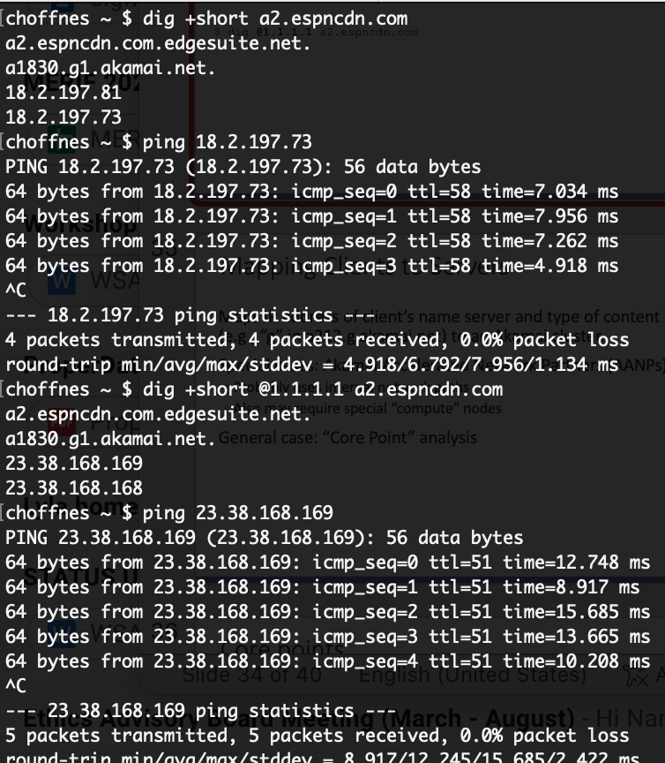

Slide 37
Mapping Clients to Servers
Maps IP address of client’s name server and type of content being requested (e.g., “g” in a212.g.akamai.net) to an Akamai cluster.
Special cases: Akamai Accelerated Network Partners (AANPs)
  Probably uses internal network paths
  Also may require special “compute” nodes
General case: “Core Point” analysis

Slide 38

Core points
Do we need to measure every path?

Slide 39
Core points
Core point is the first router at which all paths to nameservers intersect
Traceroute once per day from 300 clusters to
280,000 core points
R3
R2
R2
R1

Slide 40
Core points
280,000 nameservers (98.8% of requests) reduced to 30,000 core points
  Nice order-of-magnitude reduction
ping core points every 6 minutes
  More than 200 probes per second per server!
Note the use of low-rate expensive measurements with high-rate cheap measurements

Slide 41
Server clusters

Slide 42
Key future challenges
Mobile networks
  Latency in cell networks is higher
  Internal network structure is more opaque
Video
  4k/8k UHD = 16-30K Kbps compressed
  25K Tbps projected
  Big data center networks not enough (5 Tbps each)
  Multicast (from end systems) potential solution
China
  Local laws prohibit content on servers in China w/o license
  Need to work with local CDNs to establish presence

