Slide 1
CS 4700 / CS 5700
Network Fundamentals
Lecture 13: Middleboxes and NAT
(Duct tape for IPv4)
Revised 10/25/2021

Slide 2

Middleboxes
Devices in the network that interact with network traffic from the IP layer and up
Common functions
  NAT
  Firewall and other security
  Proxy
  Shaping
  Filtering
  Caching
  …
Internet

Slide 3
Interactive: Shaping in Mobile Networks
Download the “Wehe” app
  iOS and Android apps (>200k installs)
  Replays real app traffic
  Uses “bit inversion” as control traffic
Run some tests
  Turn off Wifi
  Use default or select more/fewer apps to test
  Tap “Run tests” and leave the app in the foreground
    When done, try again with WiFi enabled
  We’ll come back to this later in the lecture

Slide 4
Outline
NAT
Other middleboxes

Slide 5
The IPv4 Shortage
Problem: consumer ISPs typically only give one IP address per-household
  Additional IPs cost extra
  More IPs may not be available
Today’s households have more networked devices than ever
  Laptops and desktops
  TV, bluray players, game consoles
  Tablets, smartphones, eReaders
  Fridge, toaster, oven, …
How to get all these devices online?

Slide 6
Private IP Networks
Idea: create a range of private IPs that are separate from the rest of the network
  Use the private IPs for internal routing
  Use a special router to bridge the LAN and the WAN
Properties of private IPs
  Not globally unique
  Usually taken from non-routable IP ranges (why?)
Typical private IP ranges
  10.0.0.0 – 10.255.255.255
  172.16.0.0 – 172.31.255.255
  192.168.0.0 – 192.168.255.255

Slide 7
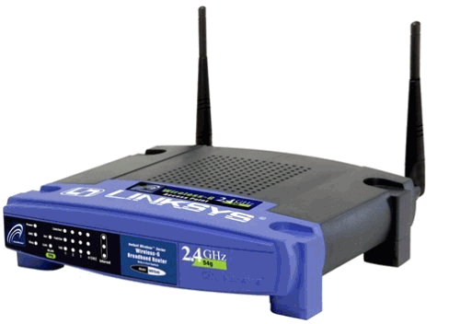
Private Networks
Private
Network
192.168.0.1
192.168.0.1
Private
Network
192.168.0.2
192.168.0.2
Internet
NAT
192.168.0.0
192.168.0.0
66.31.210.69

Slide 8
Network Address Translation (NAT)
NAT allows hosts on a private network to communicate with the Internet
  Warning: connectivity is not seamless
Special router at the boundary of a private network
  Replaces internal IPs with external IP
    This is “Network Address Translation”
  May also replace TCP/UDP port numbers
Maintains a table of active flows
  Outgoing packets initialize a table entry
  Incoming packets are rewritten based on the table

Slide 9
Basic NAT Operation
Private Network
Internet
Source: 192.168.0.1
Dest: 74.125.228.67
Source: 66.31.210.69
Dest: 74.125.228.67
Private Address | Public Address
192.168.0.1:2345 | 74.125.228.67:80
192.168.0.1
66.31.210.69
74.125.228.67
Source: 74.125.228.67
Dest: 192.168.0.1
Source: 74.125.228.67
Dest: 66.31.210.69

Slide 10
Advantages of NATs
Allow multiple hosts to share a single public IP
Allow migration between ISPs
  Even if the public IP address changes, you don’t need to reconfigure the machines on the LAN
Load balancing
  Forward traffic from a single public IP to multiple private hosts

Slide 11


Natural Firewall
Private Network
Internet
Private Address | Public Address
192.168.0.1
66.31.210.69
74.125.228.67
Source: 74.125.228.67
Dest: 66.31.210.69
Source: 74.125.228.67
Dest: 192.168.0.1

Slide 12
Concerns About NAT
Performance/scalability issues
  Per flow state!
  Modifying IP and Port numbers means NAT must recompute IP and TCP checksums
Breaks the layered network abstraction
Breaks end-to-end Internet connectivity
  192.168.*.* addresses are private
  Cannot be routed to on the Internet
  Problem is worse when both hosts are behind NATs
What about IPs embedded in data payloads?

Slide 13

Port Forwarding
Private Network
Internet
Private Address | Public Address
192.168.0.1:7000 | *.*.*.*:*
192.168.0.1
66.31.210.69
74.125.228.67
Source: 74.125.228.67:8679
Dest: 192.168.0.1:7000
Source: 74.125.228.67:8679
Dest: 66.31.210.69:7000

Slide 14

Hole Punching
Problem: How to enable connectivity through NATs?
NAT 1
NAT 2
192.168.0.2
192.168.0.1
66.31.210.69
59.1.72.13
Two application-level protocols for hole punching
  STUN
  TURN

Slide 15

STUN
Session Traversal Utilities for NAT
  Use a third-party to echo your global IP address
  Also used to probe for symmetric NATs/firewalls
    i.e. are external ports open or closed?
What is my global IP address?
Please echo my IP address
Your IP is 66.31.210.69
192.168.0.1
STUN Server
66.31.210.69

Slide 16
Problems With STUN
Only useful in certain situations
  One peer is behind a symmetric NAT
  Both peers are behind partial NATs
Not useful when both peers are behind full NATs
NAT 1
NAT 2
192.168.0.2
192.168.0.1
66.31.210.69
59.1.72.13

Slide 17
TURN
Traversal Using Relays around NAT
NAT 1
NAT 2
192.168.0.2
192.168.0.1
Please connect to me on 66.31.210.69:7000
192.168.0.1:7000
192.168.0.2:7000
66.31.210.69
59.1.72.13
TURN Server

Slide 18
Outline
NAT
Other middleboxes
  Firewall
  Cache
  Proxy
  Shaper/Policer

Slide 19
Firewall
A device that blocks traffic according to a set of rules
  Why?
  Services with vulnerabilities turned on by default
  ISP policy forbidding certain traffic due to ToS
Typically specified using a 5-tuple
  E.g., block outbound SMTP; block inbound SQL server reqs
GFC (Great Firewall of China)
  Known to block based on IP, filter DNS requests, probe endpoints, etc

Slide 20
Web caching
ISP installs cache near network edge that caches copies of Web pages
  Why?
  Performance: Content is closer to clients, TCP will perform better with lower RTTs
  Cost: “free” for the ISP to serve from inside the network

Slide 21
Web caching
ISP installs cache near network edge that caches copies of Web pages
  Why?
  Performance: Content is closer to clients, TCP will perform better with lower RTTs
  Cost: “free” for the ISP to serve from inside the network
Not cached
foo.htm
Internet
foo.htm
foo.htm
foo.htm

Slide 22
Web caching
ISP installs cache near network edge that caches copies of Web pages
  Why?
  Performance: Content is closer to clients, TCP will perform better with lower RTTs
  Cost: “free” for the ISP to serve from inside the network
Limitations
  Much of today’s content is not static (why does this matter?)
  HTTPS everywhere (why does this matter?)
  Content ownership
  Potential privacy issues
  Long tail of content popularity

Slide 23
Proxying
Non-split connections
  Forward traffic to a different IP/port (like a tunnel)
  Can be local or remote
M
C
S
Syn
Ack
SynAck/Req
Resp

Slide 24
Proxying
Non-split connections
  Forward traffic to a different IP/port (like a tunnel)
  Can be local or remote
Split connections
  Middlebox maintains two flows:
  C-M and M-S
  Can be done transparently
    How?
C
M
S
Syn
Syn
Ack
Ack
SynAck
SynAck

Slide 25
Proxying
Advantages
  RTT is lower on each end
  Can use different MTUs
  Particularly useful in cell networks
Disadvantages
  Extra delay can be bad for
  small flows
  Buffering/state makes it
  potentially costly
C
M
S
Syn
Syn
Ack
Ack
SynAck
SynAck

Slide 26
Shaping
ISPs are often charged according to 95% model
  Internet usage is very “peaky”, e.g., at 8pm, or when Mandalorian season 3 is released
To control costs, some ISPs
shape client traffic
  Time-of day
  Traffic type
Common implementations
  Token Bucket (see next deck)
  RSTs
95%
Savings
over peak
Throughput samples

Slide 27
Shaping in Mobile Networks
Check out https://wehe.meddle.mobi
  iOS and Android apps (>200k installs)
  Replays real app traffic
  Uses “bit inversion” as control traffic
Key findings
  Nearly all cellular ISPs in the US throttle traffic
  We also can reveal how they detect apps
  Can lead to misclassification

Slide 28
How do middleboxes select traffic?
Deep packet inspection (DPI)
  Looks at the contents of traffic (application-layer) for keywords
  How should “Galaxy Wars Multiplayer” be classified?
    Confused with BBC’s iPlayer (video)
  Where won’t this work?
    Encrypted connections (sort of)
  Why is this potentially a problem for net neutrality?

Slide 29
How might you break this?
Key observation: Middleboxes infer e2e state they can’t see
  Systematically violate those assumptions
  Use transport/network layer changes

Slide 30
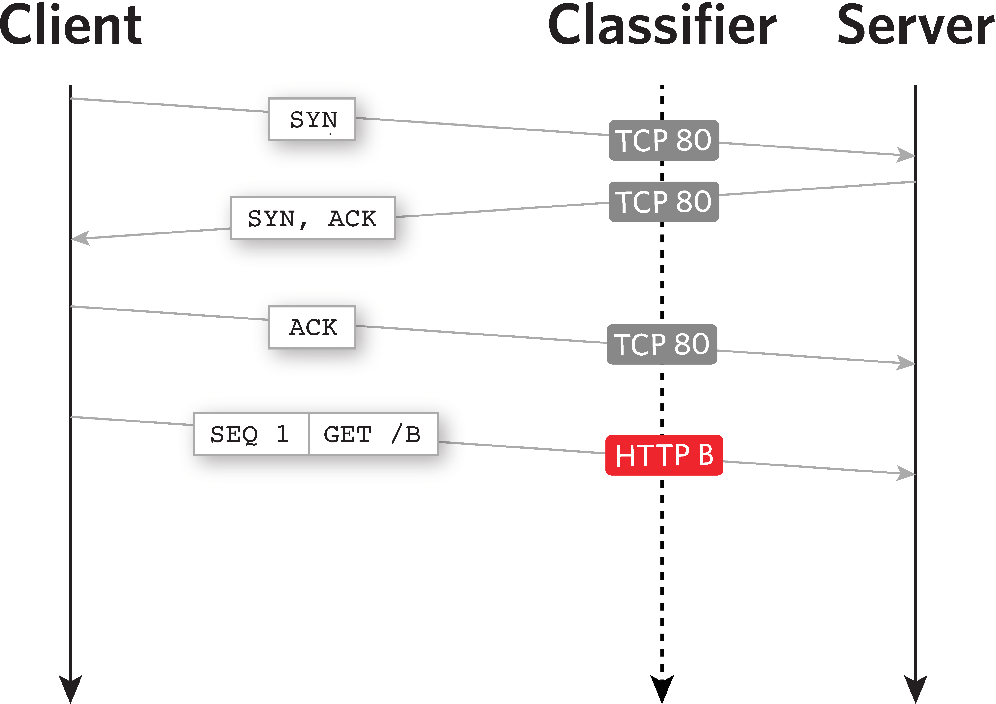
Normal behavior

Slide 31
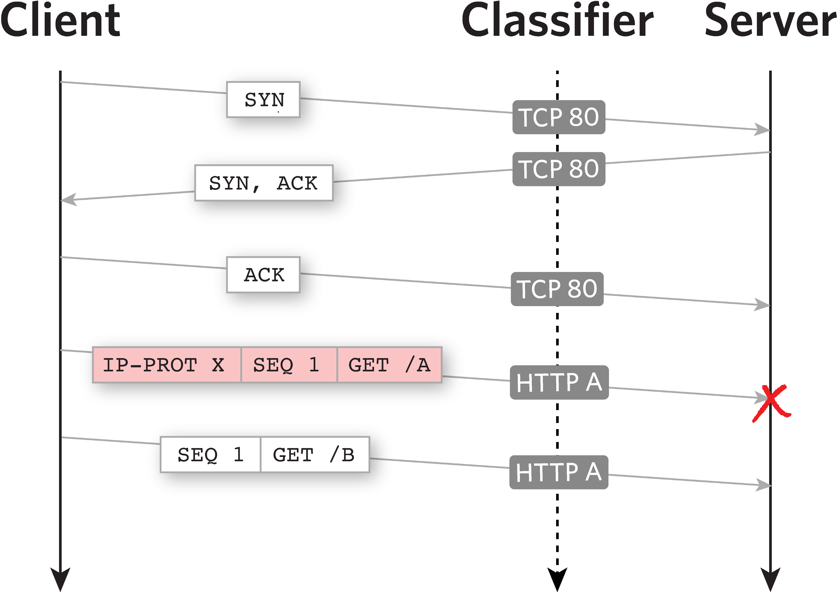
Invalid IP header

Slide 32
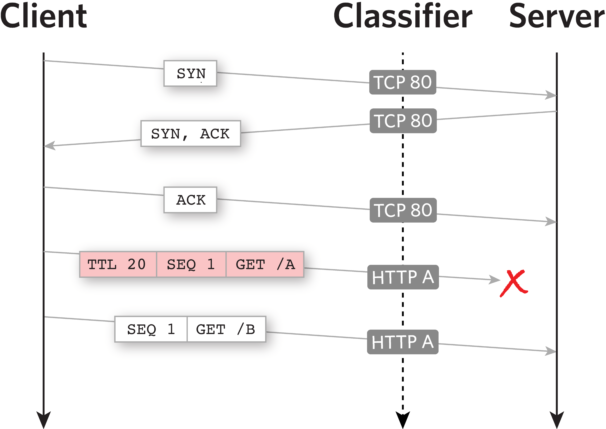
Use TTL-limited probes

Slide 33
Additional evasion techniques

Slide 34
Overall results
We can evade/confuse middleboxes
  T-Mobile: We can make all traffic free
  Great Firewall of China, Iran: Evade censorship
See https://wehe.meddle.mobi/liberate.html for more details

Slide 35
Summary
Middleboxes are pervasive in today’s networks
  Security
  Performance
  Network engineering
Pros
  Allow the network to provide functionality not provided by IP
  Can protect the network from client misconfigurations
Cons
  Break the end-to-end model, by operating at layer 3
  Can threaten net neutrality
  One more point of failure

