Slide 1
CS 4700 / CS 5700
Network Fundamentals
Lecture 18: P2P and BitTorrent
(I swear I only use it for Linux ISOs)
Revised 3/30/15

Slide 2
Traditional Internet Services Model
Client-server
  Many clients, 1 (or more) server(s)
  Web servers, DNS, file downloads, video streaming
Problems
  Scalability: how many users can a server support?
    What happens when user traffic overload servers?
    Limited resources (bandwidth, CPU, storage)
  Reliability: if # of servers is small, what happens when they break, fail, get disconnected, are mismanaged by humans?
  Efficiency: if your users are spread across the entire globe, how do you make sure you answer their requests quickly?

Slide 3
The Alternative: Peer-to-Peer
A simple idea
  Users bring their own resources to the table
  A cooperative model: clients = peers = servers
The benefits
  Scalability: # of “servers” grows with users
    BYOR: bring your own resources (storage, CPU, B/W)
  Reliability: load spread across many peers
    Probability of them all failing is very low…
  Efficiency: peers are distributed
    Peers can try and get service from nearby peers

Slide 4
The Peer-to-Peer Challenge
What are the key components for leveraging P2P?
  Communication: how do peers talk to each other
  Service/data location: how do peers know who to talk to
New reliability challenges
  Network reachability, i.e. dealing with NATs
  Dealing with churn, i.e. short peer uptimes
What about security?
  Malicious peers and cheating
  The Sybil attack

Slide 5
Outline
Unstructured P2P
BitTorrent Basics
µTP: Micro Transport Protocol
Cheating on BitTorrent

Slide 6

Centralized Approach
The original: Napster
  1999-2001
  Shawn Fanning, Sean Parker
  Invented at NEU
  Specialized in MP3s (but not for long)
Centralized index server(s)
  Supported all queries
What caused its downfall?
  Not scalable
  Centralization of liability

Slide 7






Napster Architecture
Napster
Central Server
B and C have the file
Log-in, upload list of files
Search for Star Wars
C
E
G
A
F
B
D

Slide 8
Centralized != Scalable?
Another centralized protocol: Maze
  Highly active network in China / Asia
  Over 2 million users, more than 13 TB transferred/day
  Central index servers run out of PKU
  Survived because RIAA/MPAA doesn’t exist in China
Why is this interesting?
  Shows centralized systems can work
    Of course have to be smart about it…
  Central servers “see” everything
    Quite useful for research / measurement studies

Slide 9
Maze Architecture
Incentive system
  Encourage people to upload
  Assess the trustworthyness of files
Maze
Central Server
Traffic Logs
Who downloaded
Who uploaded
How much data
C
E
G
A
F
B
D

Slide 10
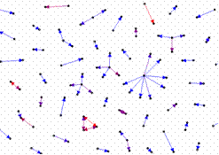
Colluding Users
  The Sybil Attack
Why and How of collusion
  Collusion gets you points in Maze (incentive system)
  Spawn fake users/identities for free
Collusion detectors (ICDCS 2007)
  Duplicate traffic across links
  Pair-wise mutual upload behavior
  Peer-to-IP ratio of clients
  Traffic concentration
  Duplicate transfer graph: 100 links w/ highest duplicate
  transfer rates

Slide 11
Unstructured P2P Applications
Centralized systems have single points of failure
Response: fully unstructured P2P
  No central server, peers only connect to each other
  Queries sent as controlled flood
  Later systems are hierarchical for performance reasons
Limitations
  Bootstrapping: how to join without central knowledge?
  Floods of traffic = high network overhead
  Probabilistic: can only search a small portion of the system
  Uncommon files are easily lost

Slide 12

Gnutella
First massively popular unstructured P2P application
  Justin Frankel, Nullsoft, 2000
  AOL was not happy at all
Original design: flat network
  Join via bootstrap node
  Connect to random set of existing hosts
  Resolve queries by localized flooding
    Time to live fields limit hops
Recent incarnations use hierarchical structure
Problems
  High bandwidth costs in control messages
  Flood of queries took up all avail b/w for dialup users

Slide 13
File Search via Flooding in Gnutella
Redundancy
What if the file is rare or far away?
Traffic Overhead

Slide 14
Peer Lifetimes
Study of host uptime and application uptime (MMCN 2002)
  Sessions are short (median is 60 minutes)
  Hosts are frequently offline
Percentage of Hosts
Host Uptime (out of 100%)

Slide 15
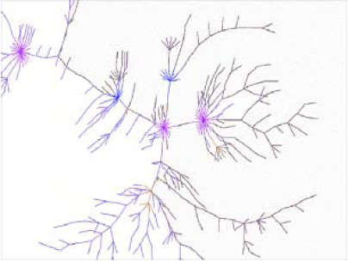
Resilience to Failures and Attacks
Previous studies (Barabasi) show interesting dichotomy of resilience for “scale-free networks”
  Resilient to random failures, but not attacks
Here’s what it looks like for Gnutella
1771 Peers in Feb, 2001
After top 4% of peers are removed
After random 30% of peers removed

Slide 16
Hierarchical P2P Networks
FastTrack network (Kazaa, Grokster, Morpheus, Gnutella++)
supernode
Improves scalability
Limits flooding
Still no guarantees of performance
What if a supernode leaves the network?

Slide 17
Kazaa
Very popular from its inception
  Hierarchical flooding helps improve scale
  Large shift to broadband helped quite a bit as well
  Based in Europe, more relaxed copyright laws
New problem: poison attacks
  Mainly used by RIAA-like organizations
  Create many Sybils that distribute “popular content”
    Files are corrupted, truncated, scrambled
    In some cases, audio/video about copyright infringement
  Quite effective in dissuading downloaders

Slide 18
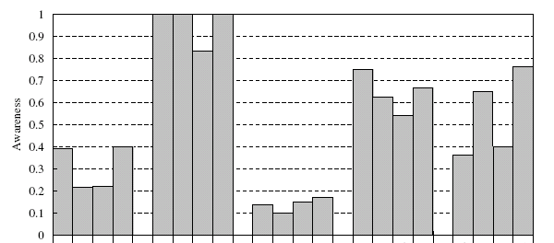
Data Poisoning on Kazaa
Why is poisoning effective? (IPTPS 2006)
  People don’t check their songs!
  Apparently not easy to detect file pollution!
Metadata
Down.Quality
Incomplete
Noise
Shuffle

Slide 19
Distribution of Poisoned Files
Why are poisoned files so widely distributed?
  “Slackness”, even when users are “asked” to check files

Slide 20

Skype: P2P VoIP
P2P client supporting VoIP, video, and text based conversation, buddy lists, etc.
  Based on Kazaa network (FastTrack)
  Overlay P2P network consisting of ordinary and Super Nodes (SN)
  Ordinary node connects to network through a Super Node
Each user registers with a central server
  User information propagated in a decentralized fashion
Uses a variant of STUN to identify the type of NAT and firewall

Slide 21
What’s New About Skype
MSN, Yahoo, GoogleTalk all provide similar functionality
  But generally rely on centralized servers
So why peer-to-peer for Skype?
  One reason: cost
    If redirect VoIP through peers, can leverage geographic distribution
    i.e. traffic to a phone in Berlin goes to peer in Berlin, thus becomes a local call
  Another reason: NAT traversal
    Choose peers to do P2P rendezvous of NAT’ed clients
Increasingly, MS is using infrastructure instead of P2P

Slide 22
Outline
Unstructured P2P
BitTorrent Basics
µTP: Micro Transport Protocol
Cheating on BitTorrent

Slide 23

What is BitTorrent
Designed for fast, efficient content distribution
  Ideal for large files, e.g. movies, DVDs, ISOs, etc.
  Uses P2P file swarming
Not a full fledged P2P system
  Does not support searching for files
  File swarms must be located out-of-band
  Trackers acts a centralized swarm coordinators
    Fully P2P, trackerless torrents are now possible
Insanely popular
  35-70% of all Internet traffic (in 2007ish)

Slide 24







BitTorrent Overview
Tracker
Swarm
Seeder
Leechers

Slide 25
.torrent File
Contains all meta-data related to a torrent
  File name(s), sizes
  Torrent hash: hash of the whole file
  URL of tracker(s)
BitTorrent breaks files into pieces
  64 KB – 1 MB per piece
  .torrent contains the size and SHA-1 hash of each piece
Basically, a .torrent tells you
  Everything about a given file
  Where to go to start downloading

Slide 26
Torrent Sites
Just standard web servers
  Allow users to upload .torrent files
  Search, ratings, comments, etc.
Some also host trackers
Many famous ones
  Mostly because they host illegal content
Legitimate .torrents
  Linux distros
  World of Warcraft patches

Slide 27
Torrent Trackers
Tracker
Really, just a highly specialized webserver
  BitTorrent protocol is built on top of HTTP
Keeps a database of swarms
  Swarms identified by torrent hash
  State of each peer in each swarm
    IP address, port, peer ID, TTL
    Status: leeching or seeding
    Optional: upload/download stats (to track fairness)
  Returns a random list of peers to new leechers

Slide 28
Peer Selection
Tracker provides each client with a list of peers
  Which peers are best?
    Truthful (not cheating)
    Fastest bandwidth
Option 1: learn dynamically
  Try downloading from many peers
  Keep only the best peers
  Strategy used by BitTorrent
Option 2: use external information
  E.g. Some torrent clients prefer peers in the same ISP

Slide 29
Sharing Pieces
Initial Seeder
1
2
3
4
5
6
7
8
1
2
3
4
5
6
7
8
1
2
3
4
5
6
7
8
Leecher
Leecher
Seeder
Seeder

Slide 30
The Beauty of BitTorrent
More leechers = more replicas of pieces
More replicas = faster downloads
  Multiple, redundant sources for each piece
Even while downloading, leechers take load off the seed(s)
  Great for content distribution
  Cost is shared among the swarm

Slide 31
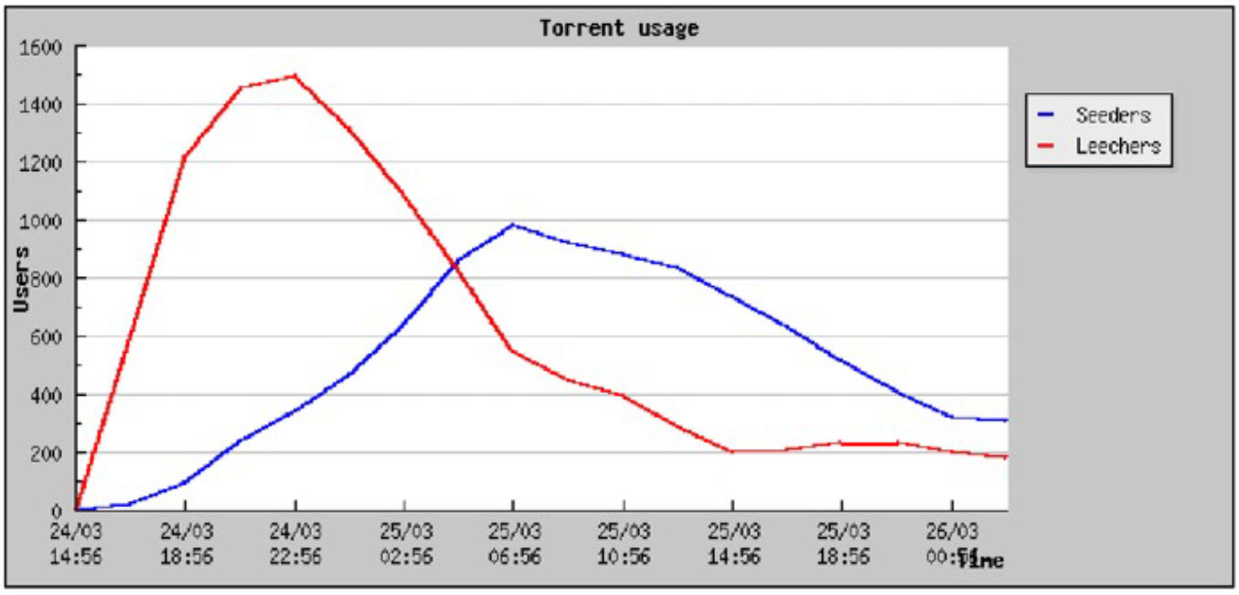
Typical Swarm Behavior

Slide 32
Sub-Pieces and Pipelining
Each piece is broken into sub-pieces
  ~16 KB in size
TCP Pipelining
  For performance, you want long lived TCP connections (to get out of slow start)
  Peers generally request 5 sub-pieces at a time
  When one finished, immediately request another
  Don’t start a new piece until previous is complete
    Prioritizes complete pieces
    Only complete pieces can be shared with other peers

Slide 33
Piece Selection
Piece download order is critical
  Worst-case scenario: all leeches have identical pieces
    Nobody can share anything :(
  Worst-case scenario: the initial seed disappears
    If a piece is missing from the swarm, the torrent is broken
What is the best strategy for selecting pieces?
  Trick question
  It depends on how many pieces you already have

Slide 34
Download Phases
0%
Bootstrap: random selection
  Initially, you have no pieces to trade
  Essentially, beg for free pieces at random
Steady-state: rarest piece first
  Ensures that common pieces are saved for last
Endgame
  Simultaneously request final pieces from multiple peers
  Cancel connections to slow peers
  Ensures that final pieces arrive quickly
% Downloaded
100%

Slide 35
Upload and Download Control
How does each peer decide who to trade with?
Incentive mechanism
  Based on tit-for-tat, game theory
  “If you give a piece to me, I’ll give a piece to you”
  “If you screw me over, you get nothing”
  Two mechanisms: choking and optimistic unchoke

Slide 36
A Bit of Game Theory
Iterated prisoner’s dilemma
Very simple game, two players, multiple rounds
  Both players agree: +2 points each
  One player defects: +5 for defector, +0 to other
  Both players defect: +0 for each
Maps well to trading pieces in BitTorrent
  Both peers trade, they both get useful data
  If both peers do nothing, they both get nothing
  If one peer defects, he gets a free piece, other peer gets nothing
What is the best strategy for this game?

Slide 37
Tit-for-Tat
Best general strategy for iterated prisoner’s dilemma
Meaning: “Equivalent Retaliation”
Rules
Initially: cooperate
If opponent cooperates, cooperate next round
If opponent defects, defect next round
Round |  |  | Points
1 | Cooperate | Cooperate | +2 / +2
2 | Cooperate | Defect | +0 / +5
3 | Defect | Cooperate | +5 / +0
4 | Cooperate | Cooperate | +2 / +2
5 | Cooperate | Defect | +0 / +5
6 | Defect | Defect | +0 / +0
7 | Defect | Cooperate | +5 / +0
 |  | Totals: | +14 / +14

Slide 38
Choking
Choke is a temporary refusal to upload
  Tit-for-tat: choke free riders
  Cap the number of simultaneous uploads
    Too many connections congests your network
  Periodically unchoke to test the network connection
    Choked peer might have better bandwidth

Slide 39
Optimistic Unchoke
Each peer has one optimistic unchoke slot
  Uploads to one random peer
  Peer rotates every 30 seconds
Reasons for optimistic unchoke
  Help to bootstrap peers without pieces
  Discover new peers with fast connections

Slide 40


BitTorrent Protocol Fundamentals
1
2
3
4
Leecher
Leecher
BitTorrent divides time into rounds
  Each round, decide who to upload to/download from
  Rounds are typically 30 seconds
Each connection to a peer is controlled by four states
  Interested / uninterested – do I want a piece from you?
  Choked / unchoked – am I currently downloading from you?
Connections are bidirectional
  You decide interest/choking on each peer
  Each peer decides interest/chocking on you

Slide 41
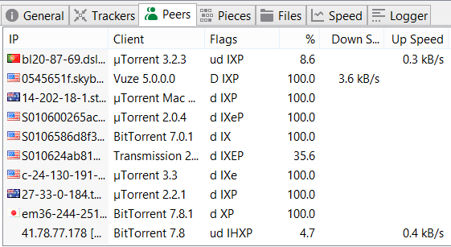
Connection States
Most peers are d or D. No need to connect with uninteresting peers.
Error states. Connection should be closed.
Download control
  d – interested and choked
  D – interested and unchoked
  K – uninterested and unchoked
  S – snubbed (no data received in 60 seconds)
  F – piece(s) failed to hash
Upload control
  u – interested and choked
  U – interested and unchoked
  O – optimistic unchoke
  ? – uninterested and unchoked
Connection information
  I – incoming connection
  E/e – Using protocol encryption
More on this later…
More on this next week
  h – used UDP hole punching
  P – connection uses µTP
How was this peer located?
  H – DHT (distributed hash table)
  L – local peer discovery (multicast)
  X – peer exchange

Slide 42
Upload-Only Mode
Once a peer completes a torrent, it becomes a seed
  No downloads, no tit-for-tat
  Who to upload to first?
BitTorrent policy
  Upload to the fastest known peer
  Why?
  Faster uploads = more available pieces
  More available pieces helps the swarm

Slide 43
Trackerless Torrents
New versions of BitTorrent have the ability to locate swarms without a tracker
  Based on a P2P overlay
  Distributed hash table (DHT)
Recall: peers located via DHT are given “H” state
More on this next week

Slide 44
Outline
Unstructured P2P
BitTorrent Basics
µTP: Micro Transport Protocol
Cheating on BitTorrent

Slide 45
BitTorrent and TCP
BitTorrent accounted for 35-70% of all Internet traffic
  Much less these days, but popular in developing regions
Thus, BitTorrent’s behavior impacts everyone
BitTorrent’s use of TCP causes problems
  Long lived, BitTorrent TCP flows are “elephants”
    Ramp up past slow start, dominate router queues
  Many applications are “mice,” get trampled by elephants
    Short lived flows (e.g. HTTP traffic)
    Delay sensitive apps (i.e. VoIP, SSH, online games)
Have you ever tried using SSH while using BitTorrent?

Slide 46
Making BitTorrent Play Nice
Key issue: long-lived TCP flows are aggressive
  TCP is constantly probing for more bandwidth
  TCP induces queuing delay in the network
Does BitTorrent really need to be so aggressive?
  BitTorrent is not delay sensitive
    Do you care if your download takes a few minutes longer?
  BitTorrent is low-priority background traffic
    You probably want to do other things on the Internet while BitTorrent is downloading
Solution: use less a less aggressive transport protocol for BitTorrent

Slide 47
Micro Transport Protocol (µTP)
Designed by BitTorrent, Inc.
UDP-based transport protocol
Uses LEDBAT principals
Duplicates many TCP features
  Window based sending, advertised windows
  Sequence numbers (packet based, not byte based)
  Reliable, in-order packet delivery
Today: widely adopted by BitTorrent clients and open-sourced

Slide 48
µTP and LEDBAT
µTP is based on IETF LEDBAT standard (RFC 6817)
Low Extra Delay Background Transport
  Low delay congestion control algorithm
  Seeks to use all available bandwidth…
  … without increasing queuing delay on the path
Goal: fast transfer of bulk data in the background
  Use all available bandwidth (fast transfer speed)
  … but, do not starve other applications
    Background data transfer is not delay sensitive
    Backoff gracefully and give bandwidth to delay sensitive applications

Slide 49
LEDBAT Details
Delay-based congestion control protocol
  Similar algorithm to TCP Vegas
  Measure one-way delay, reduce rate when delay increases
Constraint: be less aggressive than TCP
  React early to congestion and slow down
  Do not induce queuing delay in the network
LEDBAT is a “scavenger” cc protocol
  Scavenge unused bandwidth for file transfer
  … but don’t take bandwidth from other flows

Slide 50
µTP Header
Like TCP flags: SYN=4, FIN=1, RST=3, DATA=0, STATE=2 (ACK)
Random number, uniquely identifies each connection
UDP header, gives you ports
0
4
8
16
31
UDP
Source Port
Destination Port
Payload Length
Checksum
Type
Ver.
Extension
Connection ID
Timestamp (microseconds)
µTP
Version = 1
Like TCP options
Timestamp Difference (microseconds)
Advertised Window (bytes)
Sequence Number
Ack Number
Seq. and Ack. numbers like TCP
Advertised window, like TCP
Many fields are like TCP
Important new fields are the timestamps

Slide 51

Timestamps and Delay
Timestamps used to measure one-way delay
  Timestamp: time at which packet was sent
  Timestamp Difference: sent time – received time
DATA
t₀
0
Received at time t₀+100ms
Send at time t₀
ACK
t₁
100ms
Question: why use one-way delay instead of RTT?
  Queues on Internet paths are not symmetric
  Delay on the reverse path doesn’t impact the forward path
Sender knows one-way delay = 100ms
Time difference inserted into ACK

Slide 52
µTP Congestion Controller
µTP tries to keep one-way delay ~100ms
Estimate the baseline delay on the path
CCONTROL_TARGET = 100ms
base_delay = min([list of time difference samples from the last 2 minutes])
our_delay = last_time_diff_sample – base_delay
off_target = CCONTROL_TARGET – our_delay
delay_factor = off_target / CCONTROL_TARGET
window_factor = oustanding_packets / max_window
scaled_gain = MAX_CWND_INCR_PER_RTT * delay_factor * window_factor
max_window = max_window + scaled_gain
Is delay below our target (positive value),
or above our target (negative value)
Current delay on the path above the baseline
Time difference from most recent ACK
Convert units from “time” to “packets”
Finally, adjust the window size (may be + or – adjustment)

Slide 53
More µTP Details
Delay-based mechanism replaces slow start and additive increase
What if a packet drops?
  max_window = max_window * 0.5 (just like TCP)
What if off_target is a large negative number?
  max_window = 1 packet (don’t starve the connection)
Error handling in µTP :
  Uses RTO like Tahoe to retransmit lost packets
  Uses fast retransmit like TCP Reno

Slide 54
Discussion
In this case, developing a new transport protocol was (arguably) the right decision
  BitTorrent generates huge amounts of traffic
  Whole Internet benefits if BitTorrent is more friendly
However, inventing new protocols is hard
  µTP reimplements most of TCP
    RTO estimation, Nagle’s algorithm, etc.
  Early version of µTP performed much worse than TCP
    Lots of bugs related to packet pacing and sizing
Takeaway: develop new transport protocols only if absolutely necessary

Slide 55
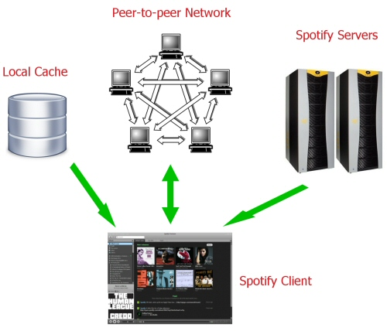
Spotify
Uses BT as basic protocol
  Uses server for first 15s
  Tries to find peers and
  download from them
  Only 8.8% of bytes come
  from servers
When 30s left
  Starts searching for next track
  Uses sever with 10s to go if
  no peers found

Slide 56
Outline
Unstructured P2P
BitTorrent Basics
µTP: Micro Transport Protocol
Cheating on BitTorrent (on your own?)

Slide 57
Incentives to Upload
Every round, a BitTorrent client calculates the number of pieces received from each peer
  The peers who gave the most will receive pieces in the next round
  These decisions are made by the unchoker
Assumption
  Peers will give as many pieces as possible each round
  Based on bandwidth constraints, etc.
Can an attacker abuse this assumption?

Slide 58
Unchoker Example
Round t
Round t + 1
13
10
10
10
4
12
10
7
9
15
10

Slide 59
Abusing the Unchocker
What if you really want to download from someone?
Round t
Round t + 1
13
10
10
4
Send a lot of data, get 1st place
Send just enough data,
get 4th place
12
10
7
9
15
10
10
20
10
11

Slide 60

Sybil Attack
Round t
Divide resources across 3 fake peers
Round t + 1
13
Only receive 10 pieces
10
10
12
10
15
10
10
42
10
14
14
Receive 30 pieces
10
14
10
Total Capacity = 42

Slide 61
BitTyrant
Piatek et al. 2007
  Implements the “come in last strategy”
  Essentially, an unfair unchoker
  Faster than stock BitTorrent
    For the Tyrant user
Problem with BitTyrant
  Tragedy of the commons
  BitTyrant performs well if most peers are honest
  As more peers use BitTyrant, performace suffers
  If all users used BitTyrant, torrents wouldn’t work at all

Slide 62
PropShare Unchoker
Goal: modify BitTorrents incentive mechanisms to mitigate “come in last” and Sybil attacks
Levin et al. 2008
  Propose PropShare unchoker
  PropShare clients allocate upload bandwidth proportionally across all peers
  There is no longer a “top four”
Can you cheat vs. PropShare?

Slide 63
PropShare Unchoker
Round t
Round t + 1
13
13/70 * upload_cap
10
10/70 * upload_cap
4
4/70 * upload_cap
12
12/70 * upload_cap
7
7/70 * upload_cap
9
9/70 * upload_cap
15
15/70 * upload_cap
Total = 70

Slide 64
PropShare Resiliency to BitTyrant
Round t
Round t + 1
13
13/90
10
10/90
4
4/90
12
12/90
7
7/90
9
9/90
15
15/90
20
20/90
Total = 90

Slide 65
PropShare Resiliency to BitTyrant
Round t
Round t + 1
13
13/81
10
10/81
4
4/81
Download always proportional to upload
No way to game the system
12
12/81
7
7/81
9
9/81
15
15/81
11
11/81
Total = 81

Slide 66
PropShare Resiliency to Sybils
Round t
Round t + 1
42
42/42
Total = 42
PropShare is Sybil resistant
14
14/42
14
14/42
14
14/42
Total = 42
Total Capacity = 42

Slide 67
Unchoker Summary
BitTyrant and PropShare are both faster than stock BitTorrent
  But for different reasons
PropShare performs comparably to BitTyrant
PropShare does not suffer from a tragedy of the commons
  i.e. it’s safe for all peers to use PropShare
  Not true for BitTyrant

Slide 68
Abusing Optimistic Unchoking
So far, assumed peers all have pieces to trade
  Thus, all peers are interesting
What about peers that have nothing?
  The bootstrap mechanism is supposed to help them
  Optimistic unchoke: reserve some bandwidth to give free pieces away (presumably to new peers)
BitThief (Locher et al. 2006)
  Abuses optimistic unchoke, uploads nothing
  Swarm collapses if all peers use BitThief

Slide 69
BitThief Details
Large-view exploit
  The swarm is (potentially) huge
  BitThief client tries to get optimistic unchoke from many, many peers
  Will only receive one free piece from each
    Since there is no reciprocal upload
  But in aggregate, this is enough to finish download
How to deal with this?
  Enlist the help of peers
  Have them verify that a given client uploads

Slide 70


Encrypted Pieces
Seeder
BitThief can’t leave, encrypted data is useless
1
2
1
2
1
2
Leecher
BitThief

Slide 71
Abusing the Endgame
Rare pieces are valuable
  Make you popular, many people want to trade with you
  More trading partners = faster downloads
Selective piece revelation
  You can’t advertise pieces you don’t have
    Peers could detect this
  But you can hide information about the pieces you have
Why is this useful?
  Pieces sent at time t impact your popularity at time t+1
  Sending common pieces first, monopolize rare pieces

Slide 72
Strategic Piece Revelation
1
2
3
4
1
2
3
4
1
2
3
4
Leecher
Leecher

Slide 73
Conclusions
BitTorrent is an extremely efficient tool for content distribution
  Strong incentive system based on game theory
  Most popular file sharing client since 2001
  More active users than YouTube and Facebook combined
However, BitTorrent is a large system with many different mechanisms
  Ample room to modify the client, alter behavior
  Cheating can happen, not all strategies are fair

